Slide 1
Radio Astronomy at Home
Aaron Clevenson
NARS
August 15, 2025

Slide 2
Agenda
What is Radio Astronomy
What the Pros Use
What Can We Do at Home
Itty-Bitty Telescope
Super SID
Meteor Observing
Radio Jove
Milky Way Galaxy

Slide 3
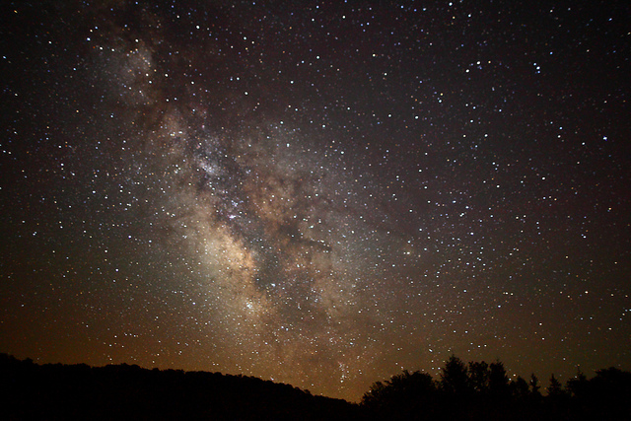
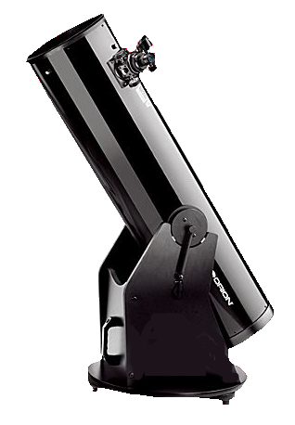
Visible Light Astronomy
Most Amateur Astronomers Observe Visible Light

Slide 4
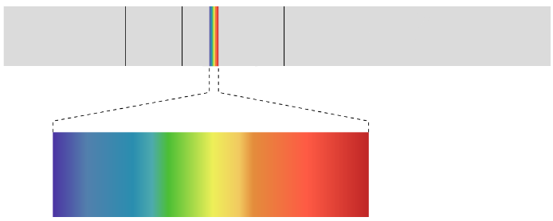
Electromagnetic Spectrum
But Light (Electromagnetic Radiation) is much more than just Visible Light
Radio Waves
IR
UV
X-Ray
Gamma Rays
Visible Light

Slide 5

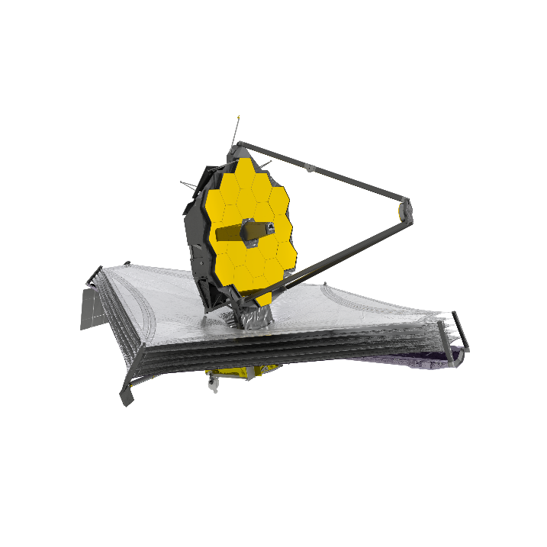
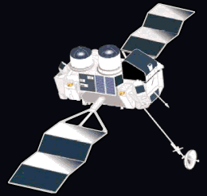
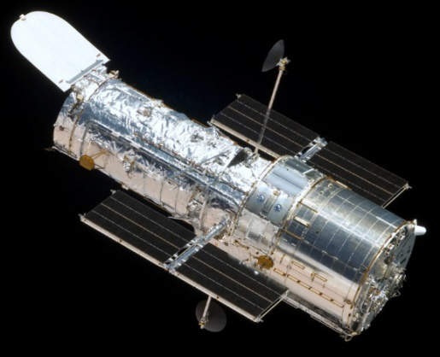
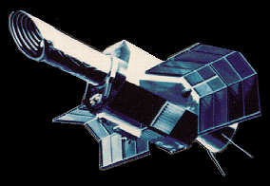
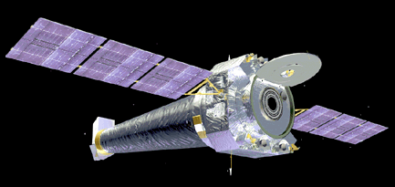
Observing Beyond the Visible
How Astronomers Do It
Radio Waves
IR
UV
X-Ray
Gamma Rays
Radio Waves
IR
UV
X-Ray
Gamma Rays
James Webb
IUE
Compton
Hubble
Chandra

Slide 6
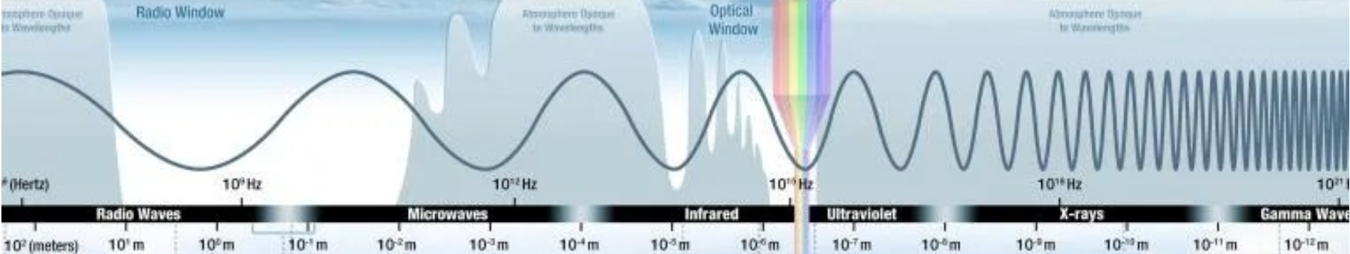
But… Some of it is filtered out by the atmosphere

Slide 7
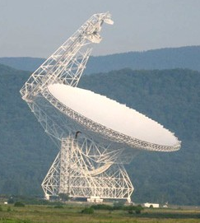
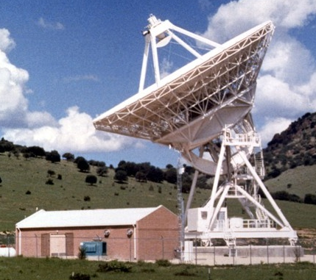
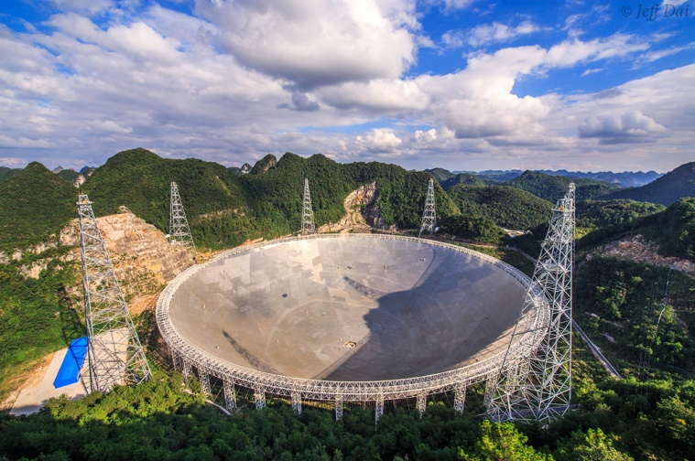
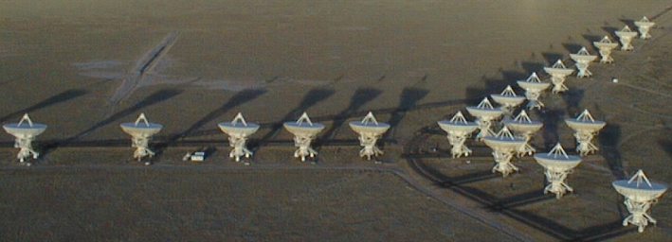
Observing Beyond the Visible
How Astronomers Do It – Radio Waves
VLBA
Radio Waves
IR
UV
X-Ray
Gamma Rays
Radio Waves
IR
UV
X-Ray
Gamma Rays
FAST
Green Bank
VLA

Slide 8
Radio Frequencies
30 GHz
3000 GHz
3 GHz
30 GHz
Itty-Bitty Telescope – 12 GHz
0.3 GHz
3 GHz
Milky Way – 1.43 GHz
0.03 GHz
0.3 GHz
Radio Meteors – 0.2 GHz
0 GHz
0.03 GHz
Super SID –
0.000025 GHz (25,000 Hz)
Radio Jove –
0.02 GHz

Slide 9
Amateur Radio Astronomy
For us to do Radio Astronomy -
We need it to be:
Inexpensive
Not too Big
Easy to Build
Easy to Use
Fun to Do

Slide 10
What Objects Can We Observe
The Sun
Jupiter
Meteors
Solar X-Ray Flares
The Milky Way

Slide 11
The Tools We Can Use
The Sun – Radio Jove, Itty-Bitty Telescope
Jupiter – Radio Jove
Meteors – FM Radio
Solar X-Ray Flares – Super SID
Milky Way – Horn antenna

Slide 12
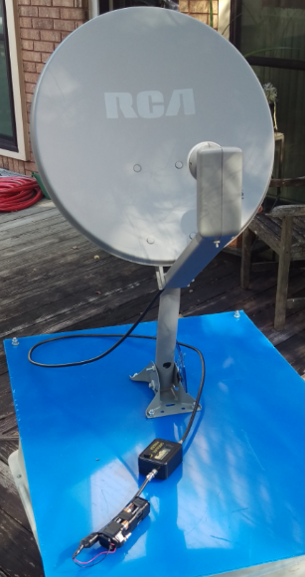

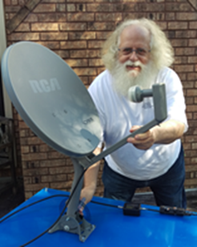
The Itty-Bitty Telescope
12 GHz
Detect the Sun
Detect Humans
Low Resolution
Uses a TV Dish
✓
http://www.setileague.org/articles/lbt.pdf

Slide 13
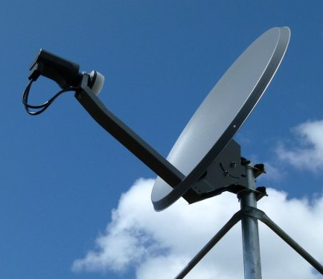
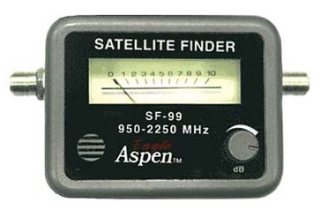
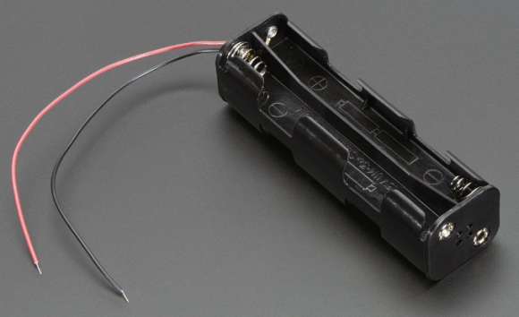
The Itty-Bitty Telescope
Parts needed
TV Dish
Signal Meter
Battery Pack
http://www.setileague.org/articles/lbt.pdf

Slide 14
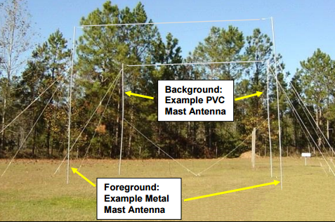
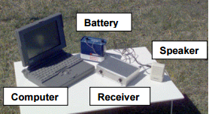
Radio Jove
Detect Jupiter
Detect the Sun
Dipole Antenna
http://radiojove.gsfc.nasa.gov/help/
✓
20.1 MHz

Slide 15

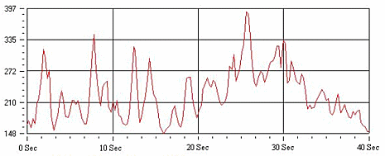
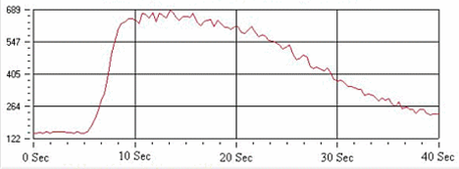
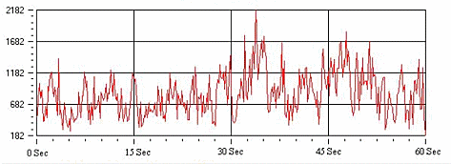
Radio Jove
Signals
Jupiter Signals: L burst (top), S burst (bottom)
Sun Signal: Solar burst

Slide 16
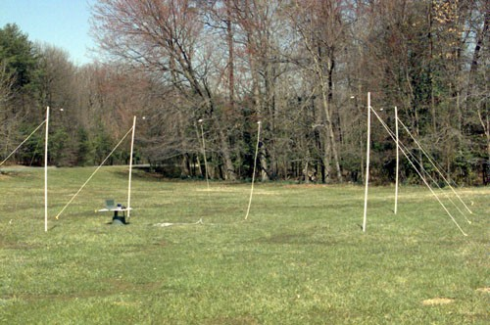
Radio Jove
Parts needed
4 Masts and guy wires
2 Dipole Antennas
Receiver
Computer
Speakers

Slide 17
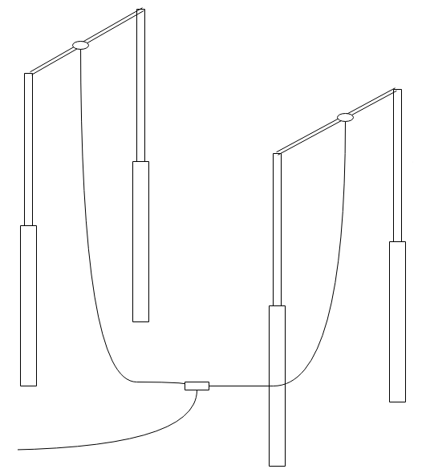
Radio Jove
The Antennas

Slide 18
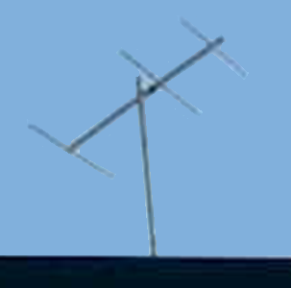
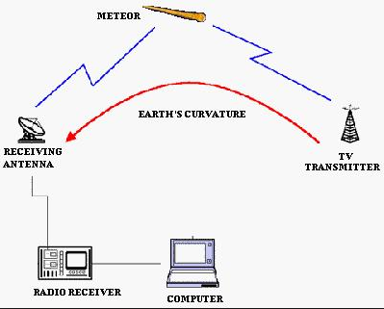
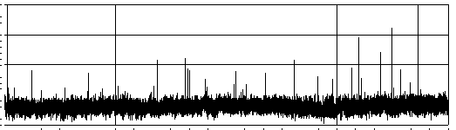
FM Radio - Meteors
✓
FM Radio or Radio Dongle for the Computer
Software to record and display signals
Antenna
http://www.skyscan.ca/meteor_radio_detection.htm

Slide 19
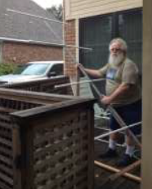
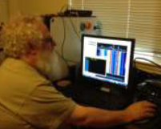
FM Radio - Meteors
Buy the computer radio dongle
Build the Antenna
Listen
200 MHz

Slide 20
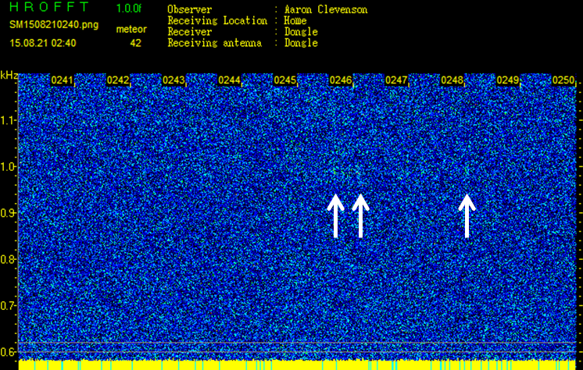
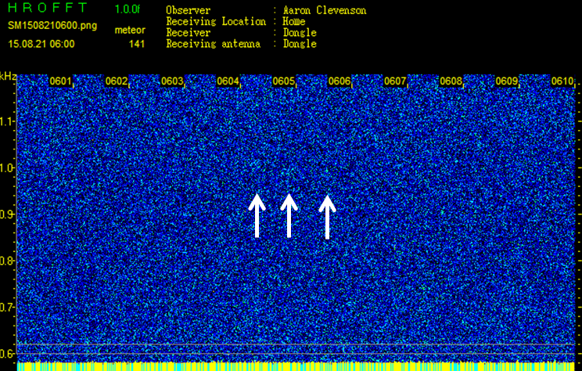
FM Radio - Meteors
My Success

Slide 21
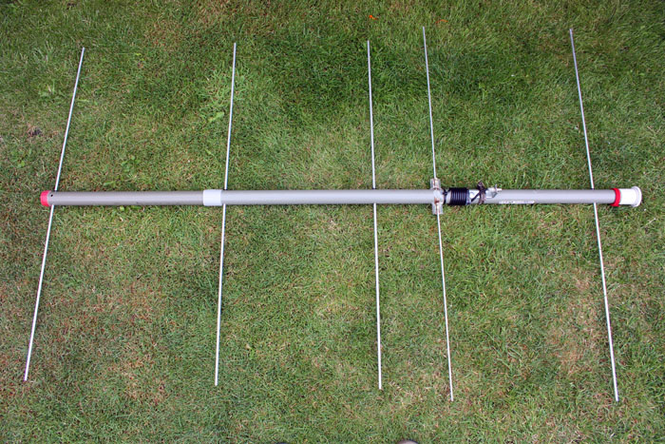
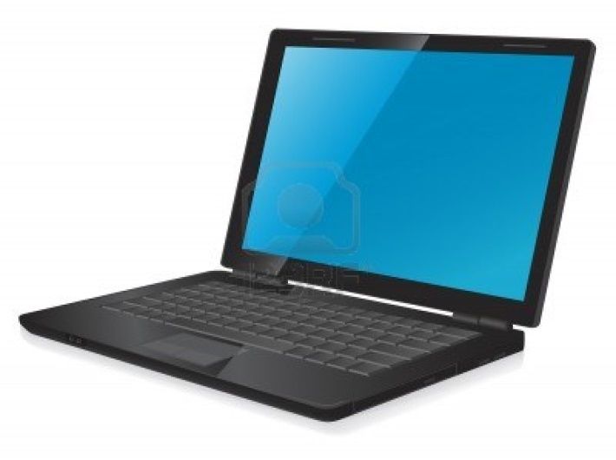
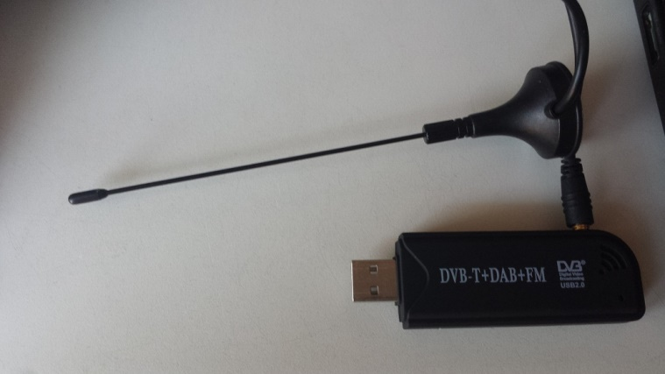
FM Radio - Meteors
Parts Needed
Antenna
Radio Dongle
Computer

Slide 22
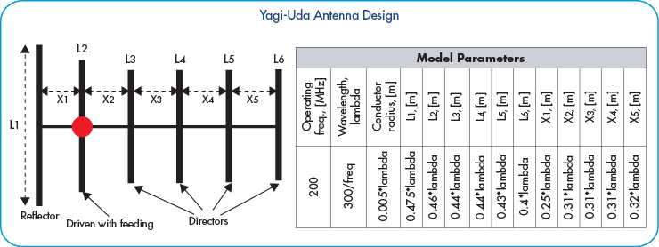
FM Radio - Meteors
Yagi Antenna Design

Slide 23
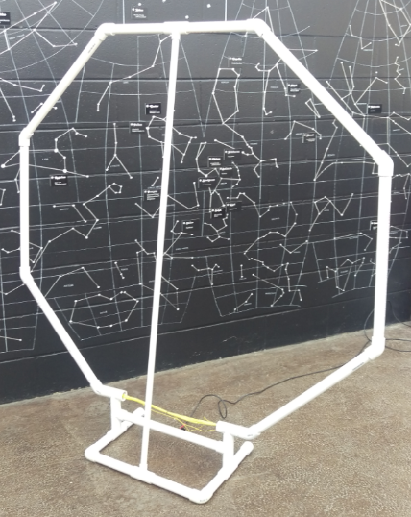
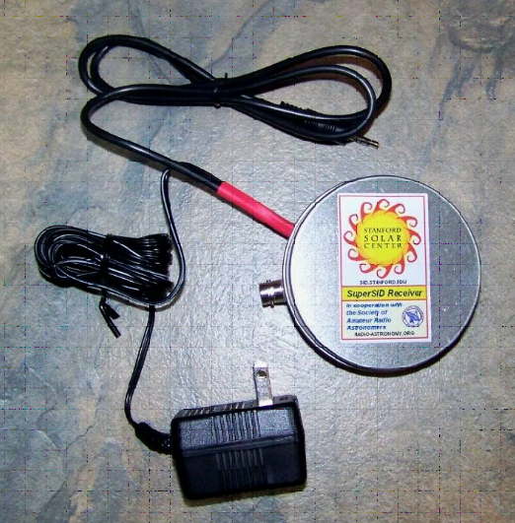
Super SID
✓
Hardware to bring the signal to your computer
Software on computer
Antenna
0.025 MHz

Slide 24
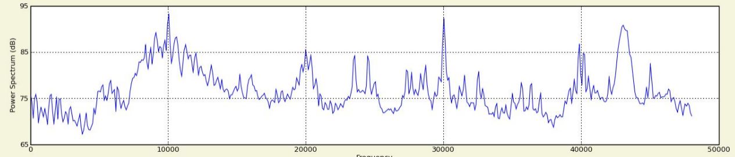
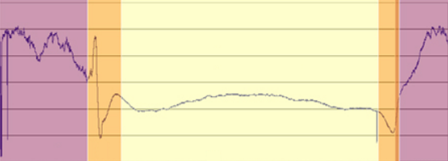
Super SID
What the computer sees
Updated every 5 seconds
A Day with no Flares
Cutler, ME, 24.0 kHz
LaMoure, ND, 25.2 kHz

Slide 25
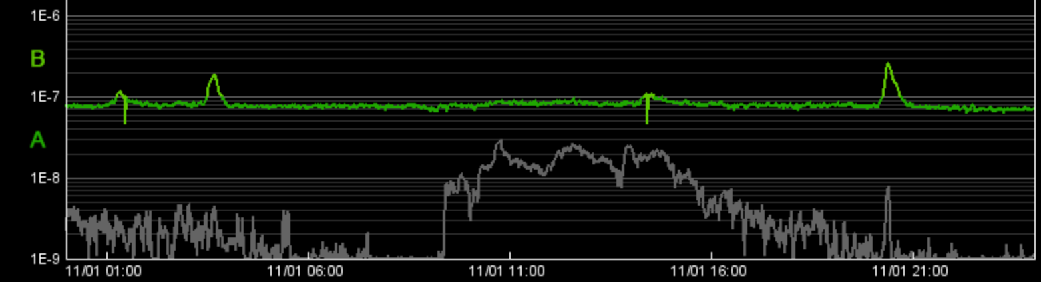
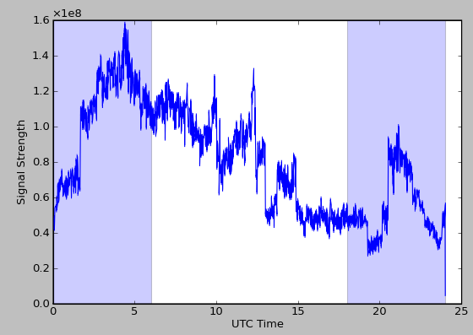
Super SID
Extremely Low
Frequency
Results – Not so good

Slide 26
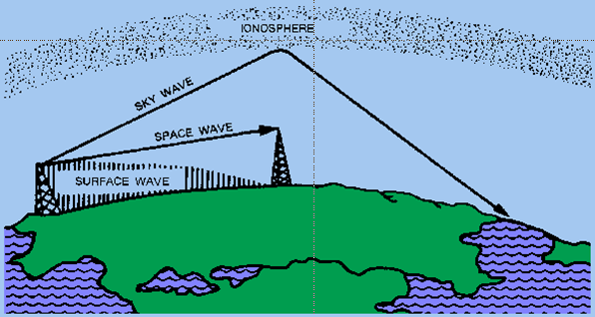
Super SID
X-Ray Flares on the Sun
Radiation Ionizes Atoms in the Ionosphere
Distant Very Low Frequency Radio Signals are Reflected by Free Electrons in the Ionosphere

Slide 27
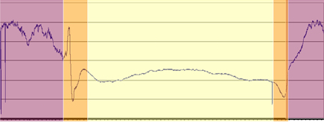
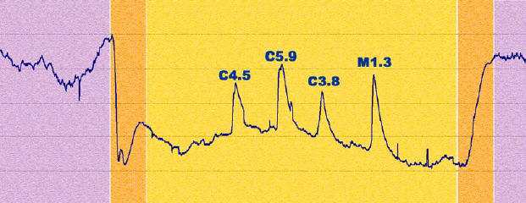
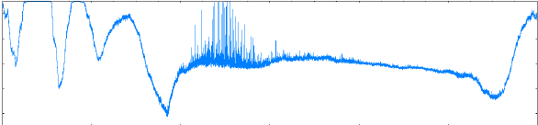
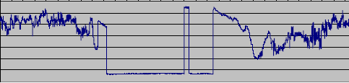
Super SID
✓
What you see…
A quiet day
Flares detected
Lightening
Off-Air
X
✓
✓

Slide 28
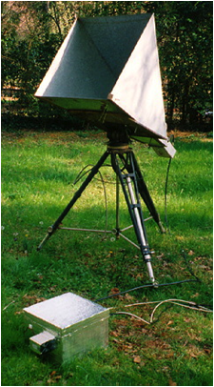
The Milky Way
Horn Antenna
Radio Receiver
Horn Antenna, cardboard and
Aluminum foil
1 gallon “paint thinner” can
Electronics

Slide 29
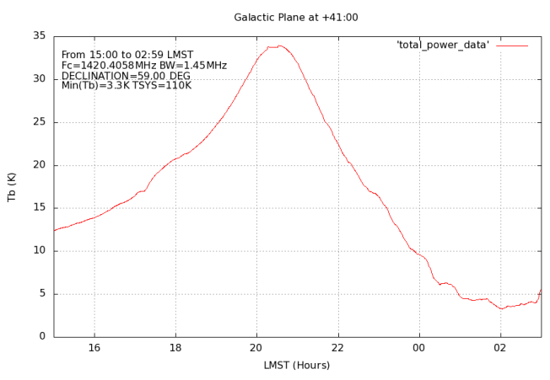
The Milky Way
Results of sky scan

Slide 30
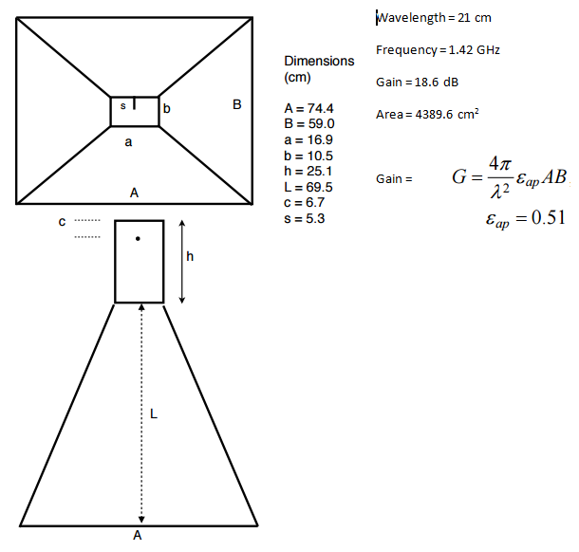
The Milky Way
Antenna Dimensions
1,430 MHz

Slide 31

The Milky Way
Electronics Details

Slide 32



The Astronomical League www.astroleague.org
Radio Astronomy Observing Program
Bronze, Silver and Gold Levels
1, 2, and 4 Techniques Respectively

Slide 33
Questions aaron@clevenson.org
?

