Slide 1
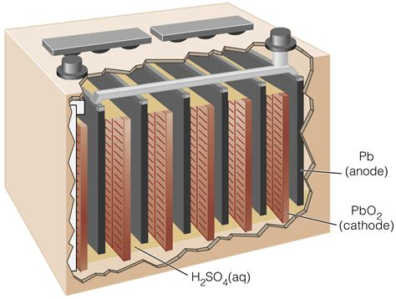
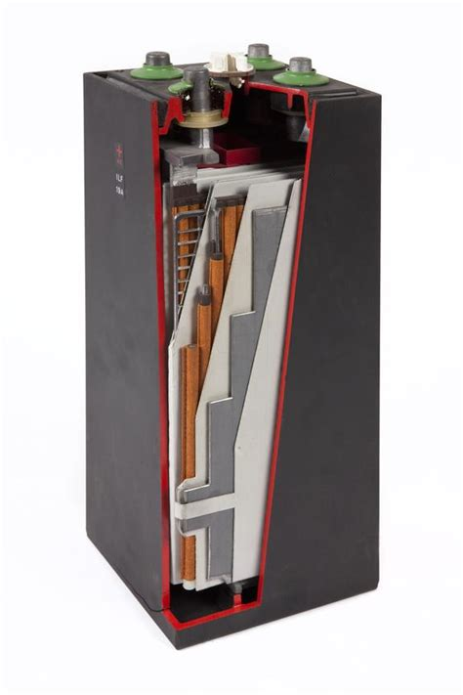
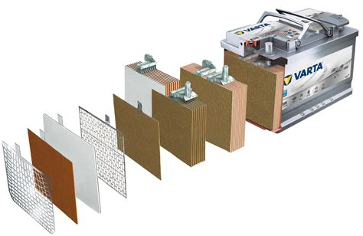
Lead-acid Battery Tech
Notes:
Wet cell - liquid electrolyte, refill cell
Maintenance free - liquid electrolyte, just left off cell caps.
VRLA - more rugged, can be mounted on side
SLA - sealed cells, no maintenance
Gel cells - gelled electrolyte
Absorbent glass mat - contains electrolyte

Slide 2
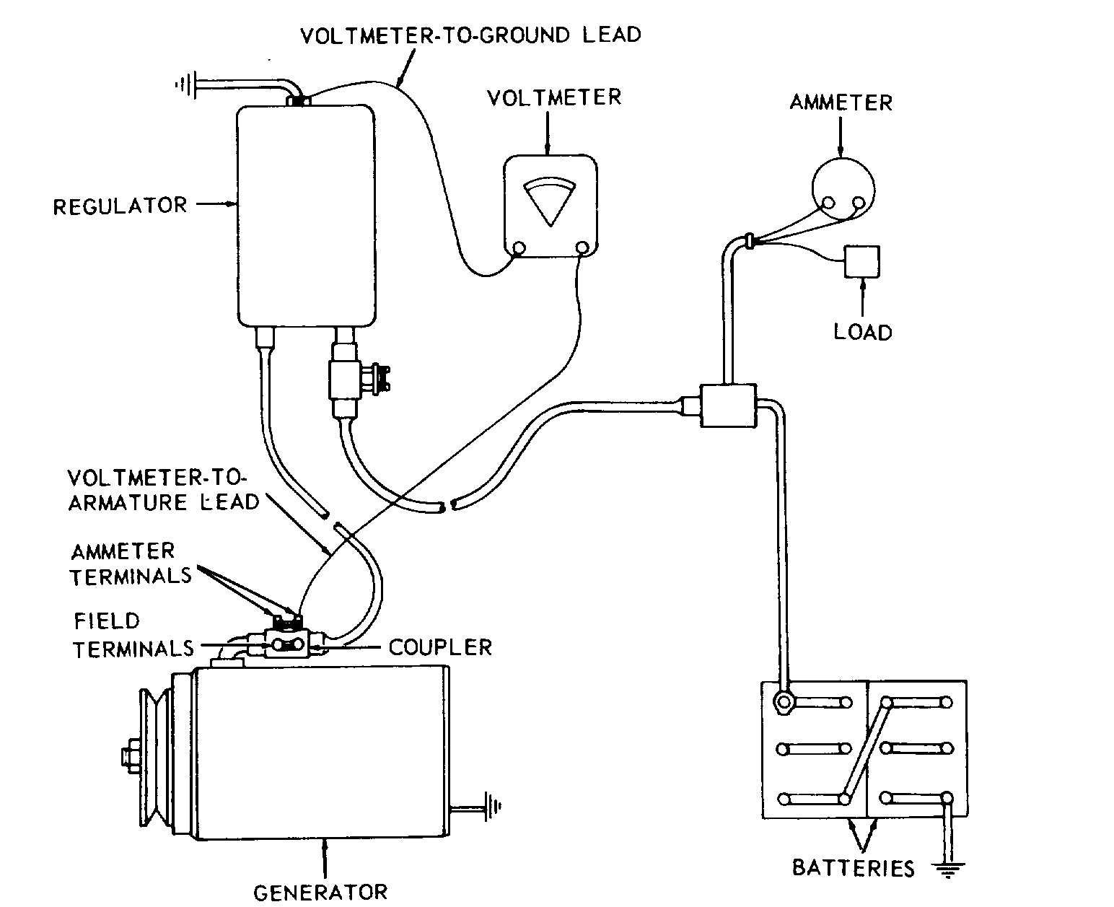
Traditional Charge Systems
Constant Current to Voltage Limit.
Notes:
Nominal open circuit voltage 12.6
Charge voltage 13.5 - 14.4
Nominal system voltage 13.8
Current auto electronic equipment usually operates from 12.8 - 14.5

Slide 3
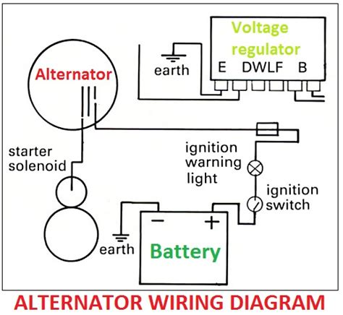
Intelligent Charge Systems
Notes:
Somewhere around the 2018 model year, several manufacturers started monitoring the battery condition and throttling the alternator so as to just supply the bare minimum charge to maintain the battery and supply the vehicle load. Most of the time, the battery supplies the load. The ecu turns the alternator on during deceleration or if the battery charge state is low. This is also intended to improve the gas mileage. The voltage is highly temperature dependent also.
Many other manufacturers have made similar alterations to their charging systems to improve fuel economy. If you have a vehicle that does the start stop thing and/or a glass-mat battery, you probably have the same issue lurking.
Voltage 12.6 to 13.0, depending on temperature, but regardless of engine rpm. When decelerating, voltage rises to 13.7, 13.9, 14.0 as engine rpm drops through 1500. At idle, voltage is back down to 12.5, then 12.6. With lights and wiper on, voltage reads 12.4, which tells me I am on battery.
If you are using the start-stop, feature the voltage can drop even further at a stop.
If I begin to accelerate before coming to a stop, the voltage drops again. Running the engine at 1200-1500 rpm in neutral does not bring the voltage back up either. Checked with multimeter, it agrees with the readings I get on the instrument panel.

Slide 4
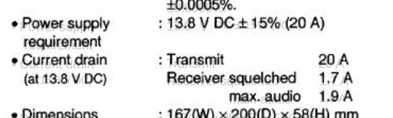
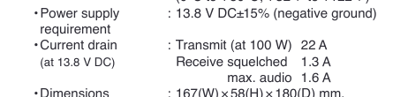
Ham Radio Gear
Notes:
Power requirements for most mobile transceivers specified at 13.8V input
Typical 100w transmitter output falls to about 80w @ 12.6v supply
Can also affect spurious outputs

Slide 5
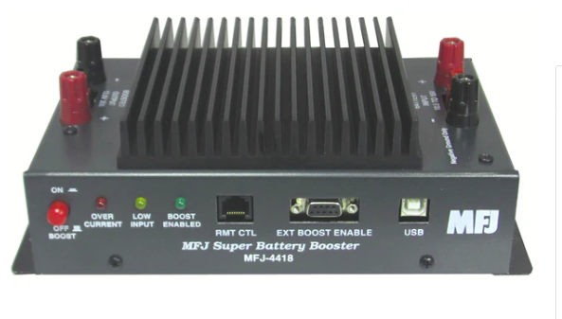
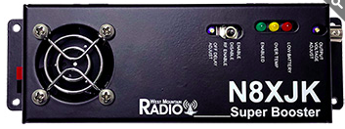
Problem identified, but what to do about it?
Notes:
I looked at two voltage stabilizers on the market, but the cost was more than I wanted to spend unless I had absolutely no other choice. Either one was as much as a new FM mobile. One is $229 and the other is $279. A new radio wouldn’t solve the basic problem either.

Slide 6
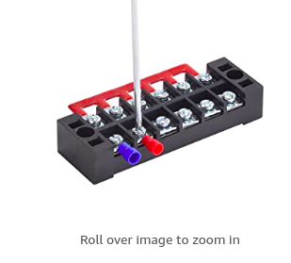
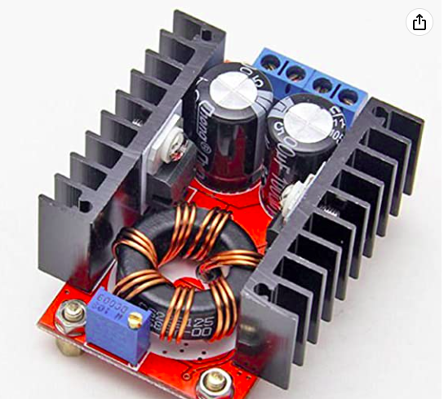
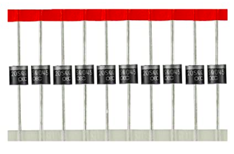
Amazon solution
Notes:
Thanks to a tip from Paul, I bought some low cost DC-DC up converters from Amazon to boost the voltage to 13.8, the nominal system voltage for most cars. This is also the nominal IC7000 input voltage. With all the parts purchased new from Amazon, I spent about $70. I have enough parts left to build a second one if needed. Or for other projects…
More about that later…

Slide 7
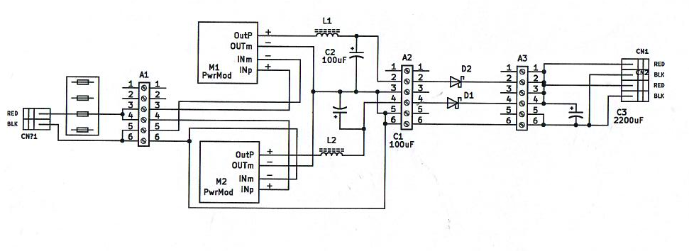
Voltage Stabilizer
Notes:
The converter modules are rated for 15 A with an input voltage rating of from 10.5 to 32 volts and an output of 12 to 35 volts. The output is adjustable with a 10-turn pot. The output is pretty ‘stiff’ until it reaches the 15 A rating and then it folds back quickly.
Because two modules are necessary to support the 7000 at full output (22 A), I fed each module output to a common output point through 20 A Schottky diodes. Because of the relatively stiff outputs and sharp current limit, balancing the two outputs is important. To keep the loading shared equally, the output voltage should match within 10 mv.

Slide 8
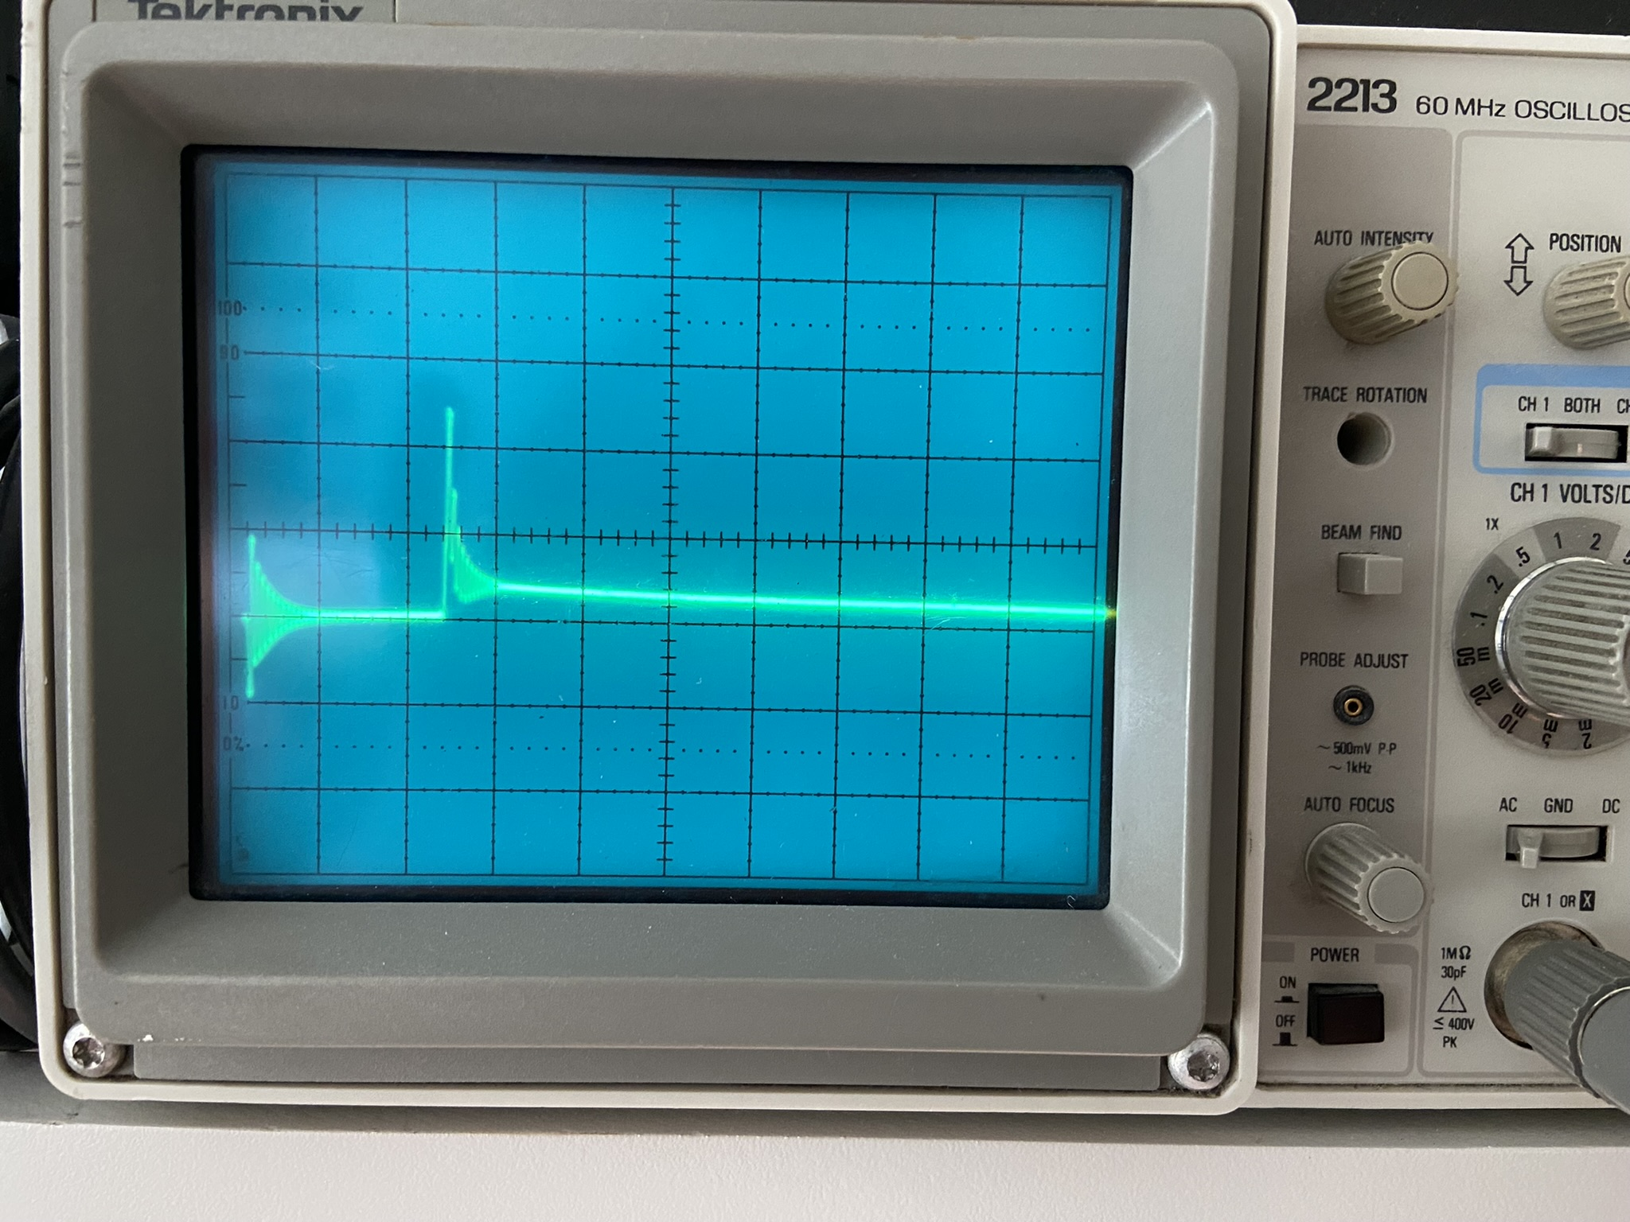
Bench Test
Notes:
A prototype build on the bench was promising, with some hash on the dc output. The scope is displaying the output of one module, before the input filtering. Frequency is around 150 kHz, and there does not seem to be any interference to the receiver, despite the lack of filtering.

Slide 9
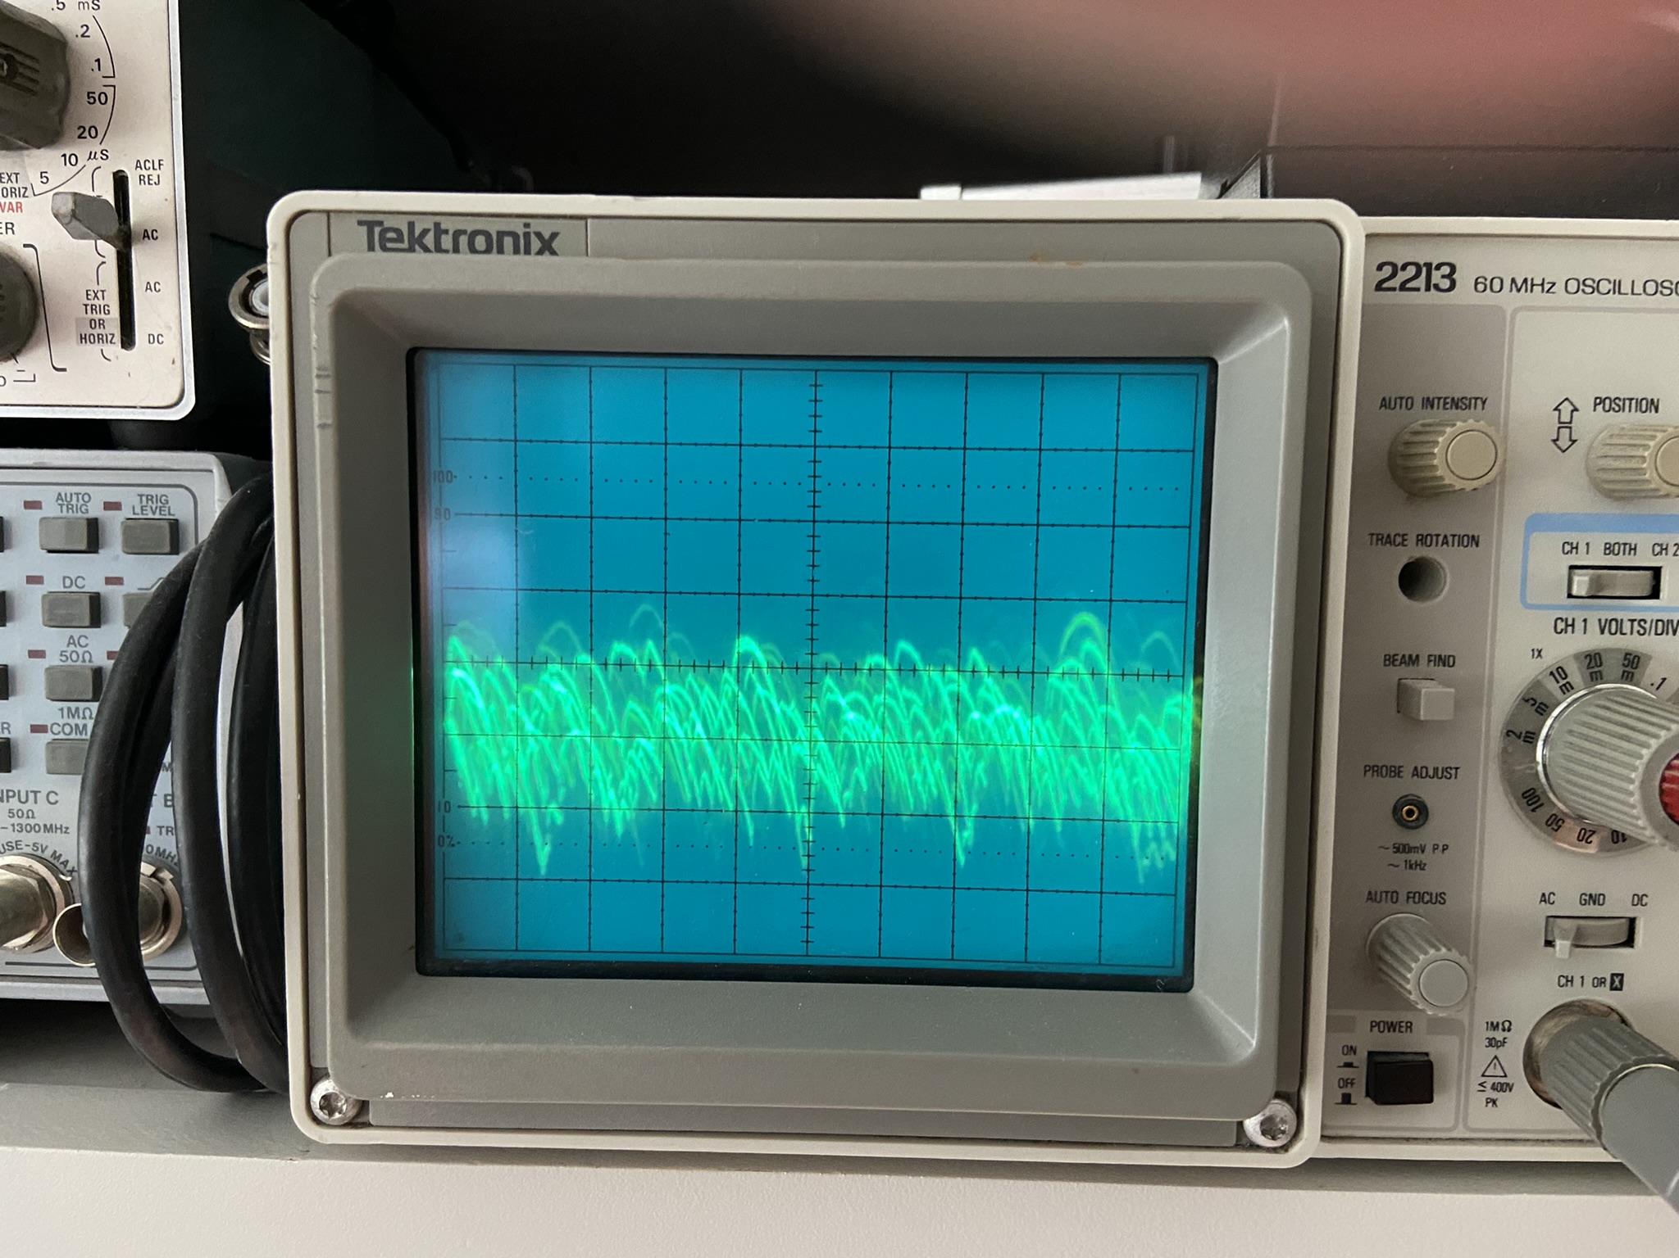
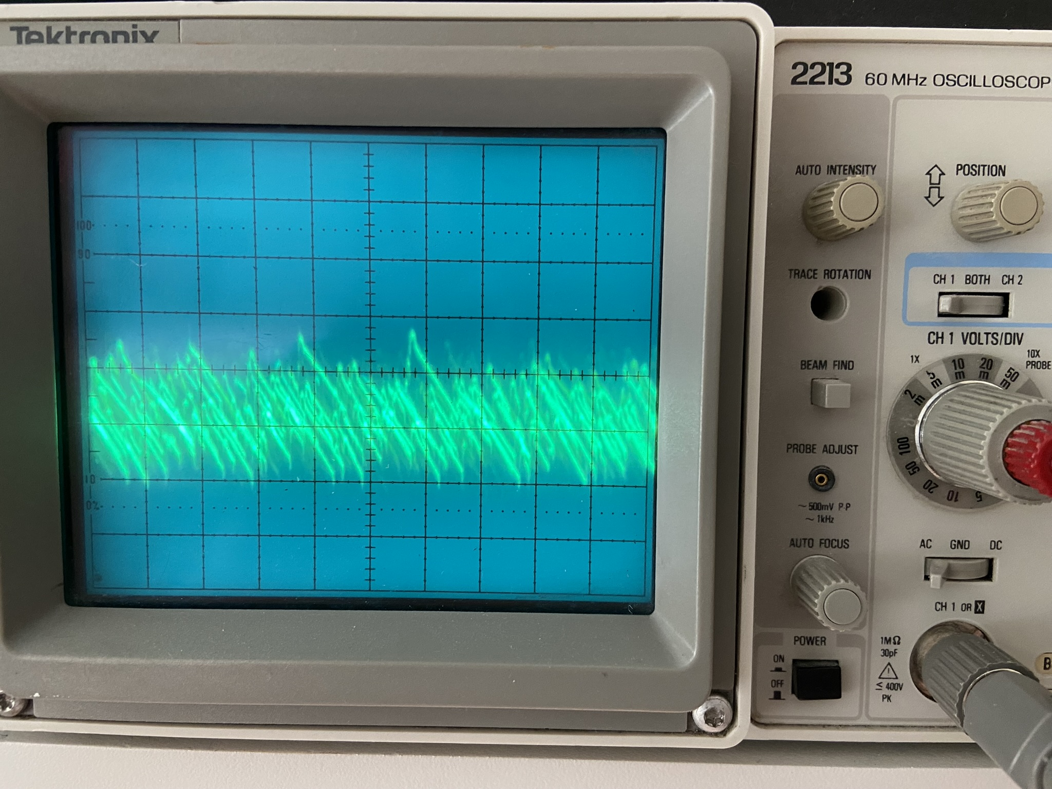
Bench Test 2
Notes:
The left picture (350mvp-p) is the output of one module before the choke. I added a choke in the output of each module, as well as 100 uF bypass capacitors before the diodes. Chokes are 12 turns on some cores I had on hand.
A final 3300 uF cap across the output produced the trace on the right. About 140mv p-p riding on the 14 v dc output.

Slide 10
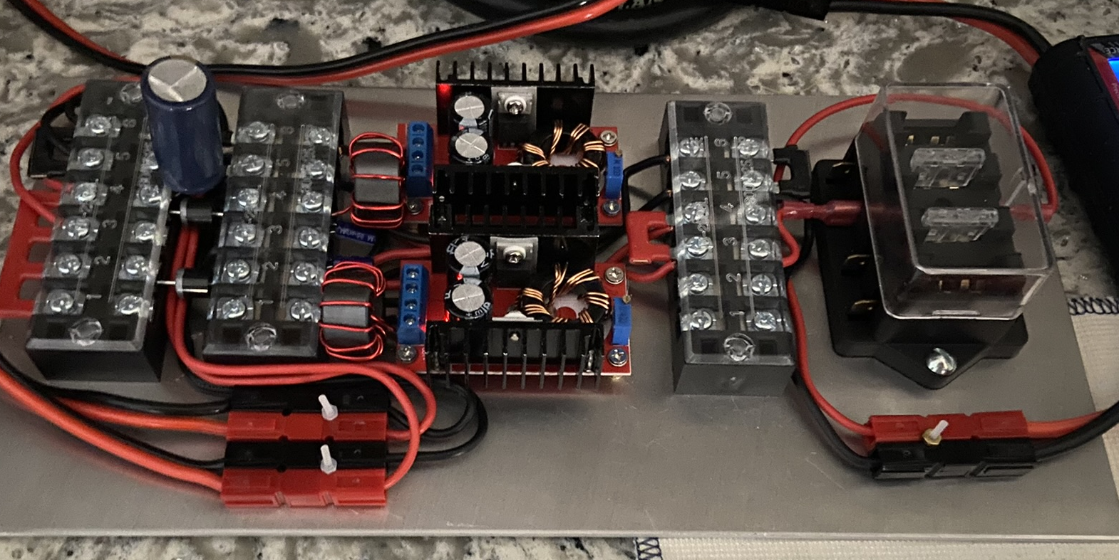
Final Assembly
Notes:
Assembly complete, ready for installation. Input on the right, output on the left.

Slide 11
Parts List
Qty Vendor Notes
DC-DC Converter 2 Amazon bundle of 5
Schottky Diode, 45V 20A 2 Amazon Pack of 10
Terminal strip, 6 Position 3 Amazon Includes crimp terminals, shorting bars
Fuseholder 1 Amazon 6 position, one pos used
Fuse, 30A 1 Amazon
Capacitor, 100 uF, 50V 2 Digikey On hand
Capacitor, 2000 uf 30V 1 Digikey On hand
Inductor 2 Mouser #43 core, .87OD x,537ID
Relay, SPDT 1 Amazon bundle of 2
PowerPole pairs, w/contacts 3 Digikey One hand
Notes:
A well-stocked junk box can provide many of the parts. I built this one of a piece of aluminium sheet from a hobby shop mainly because the stock I had on hand had been used for other projects and was looking kind of dog-eared.
I have leftovers of the Amazon parts to build one more. I could probably scrounge the remaining parts to build a second also.

Slide 12
What's Next?
Notes:
Add relay or power FET switch to cut power to the converter unless the vehicle is running. No load draw is about 30 ma. Probably OK for testing, but not something I want going on long term...
I found some power FETs on Amazon that are real cheap. The Rds-on is supposed to be .02 ohm and they are rated to carry 74A continuous. The ones from Amazon (BOJACK) were definitely poorer in quality than the two that I got from Digikey.
The drop across two Bojack FETs at 10 A was 0.46V, which suggests an Rds of .092 ohm per transistor. This would result in a drop of about 1V at 22A - far too much to give up at these voltages. The parts I got from Digikey were much better - .085V at 10A, Rds of .017 ohm - much closer to the data sheet value of .02 ohm. Two in parallel would drop .37 volts at 22A - an acceptable drop.
The biggest item is coming up with an acceptable mount for an HF antenna. The hood and lift-gate are carbon fiber, so lip-mounts are out - I am concerned that it would crack or break off. Roof mounts require a hole, so that is a no-go. Also not desirable from a convenience standpoint because it won't fit in the garage easily. A trailer hitch mount has been suggested, but that would require installation of a trailer hitch, an item I am unlikely to need otherwise. Research continues...
The VHF-UHF antenna is a thru-glass type that I am evaluating with a HT and an amplifier. Less than optimum, but it seem to be an acceptable fix for now. I can always set a mag mount on the roof for extended trips away from home where the car is in and out of the garage.

