Slide 1

Digital Communications
Digital Mentors
Ron Matusek - WA6TQH
Walter Holmes – K5WH
Marty Fitzgerald – W5MF
Paul Kent – KI5FJS
Evolution of the Hotspot
Presentation by Ron Matusek – WA6TQH

Slide 2
Evolution of the Hotspot
My objective is to encourage Hams interested in accessing Digital modes to consider alternatives currently available. Many have purchased new DMR Radio’s specifically for DMR access along with Hotspot's. This is proving to require some ongoing knowledge programming Hotspot's and DMR Radio Code Plugs.
I would like to introduce you to a new Hotspot coming into the mainstream that will allow you to access ALLstar, EchoLink, and all Digital Modes just by using your existing analog UHF/VHF HT in SIMPLEX MODE. This means a one time investment of a Hotspot (pre-programmed) without purchasing a special Radio for interface.
The following information presented is an overview of Hotspot evolution. If enough interest, we will establish a more in-depth technical discussion.

Slide 3
Types of Hotspot Hardware
Hardware | Simplex / Duplex | Comments
Zumspot | Simplex | visibility of Time Slot #2 only
Jumbospot | Simplex | Chinese version of above
Pi-Zero Wi-Fi board | -- | used with above to provide wi-fi access
Banana Pi BPI-M2 Zero | -- | Chinese version of Pi Zero
SharkRF Openspot 1 | Simplex | Late 2018 - Discontinued production Ethernet; need external wi-fi interface
Duplex board | Duplex | split channel operation visibility of Time Slots #1 & #2
Raspberry Pi-3 b+ | -- | required for Duplex Board adds more power & flexibility for addons i.e. Larger display such as a Nextion LCD

Slide 4
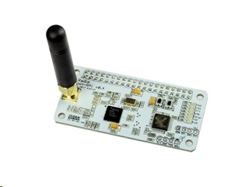
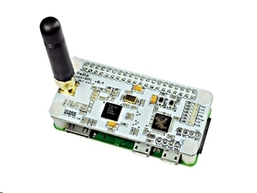
Zumspot assembly
Zumspot assembly
Zumspot with Pi-Zero W attached
HRO = $249.95

Slide 5
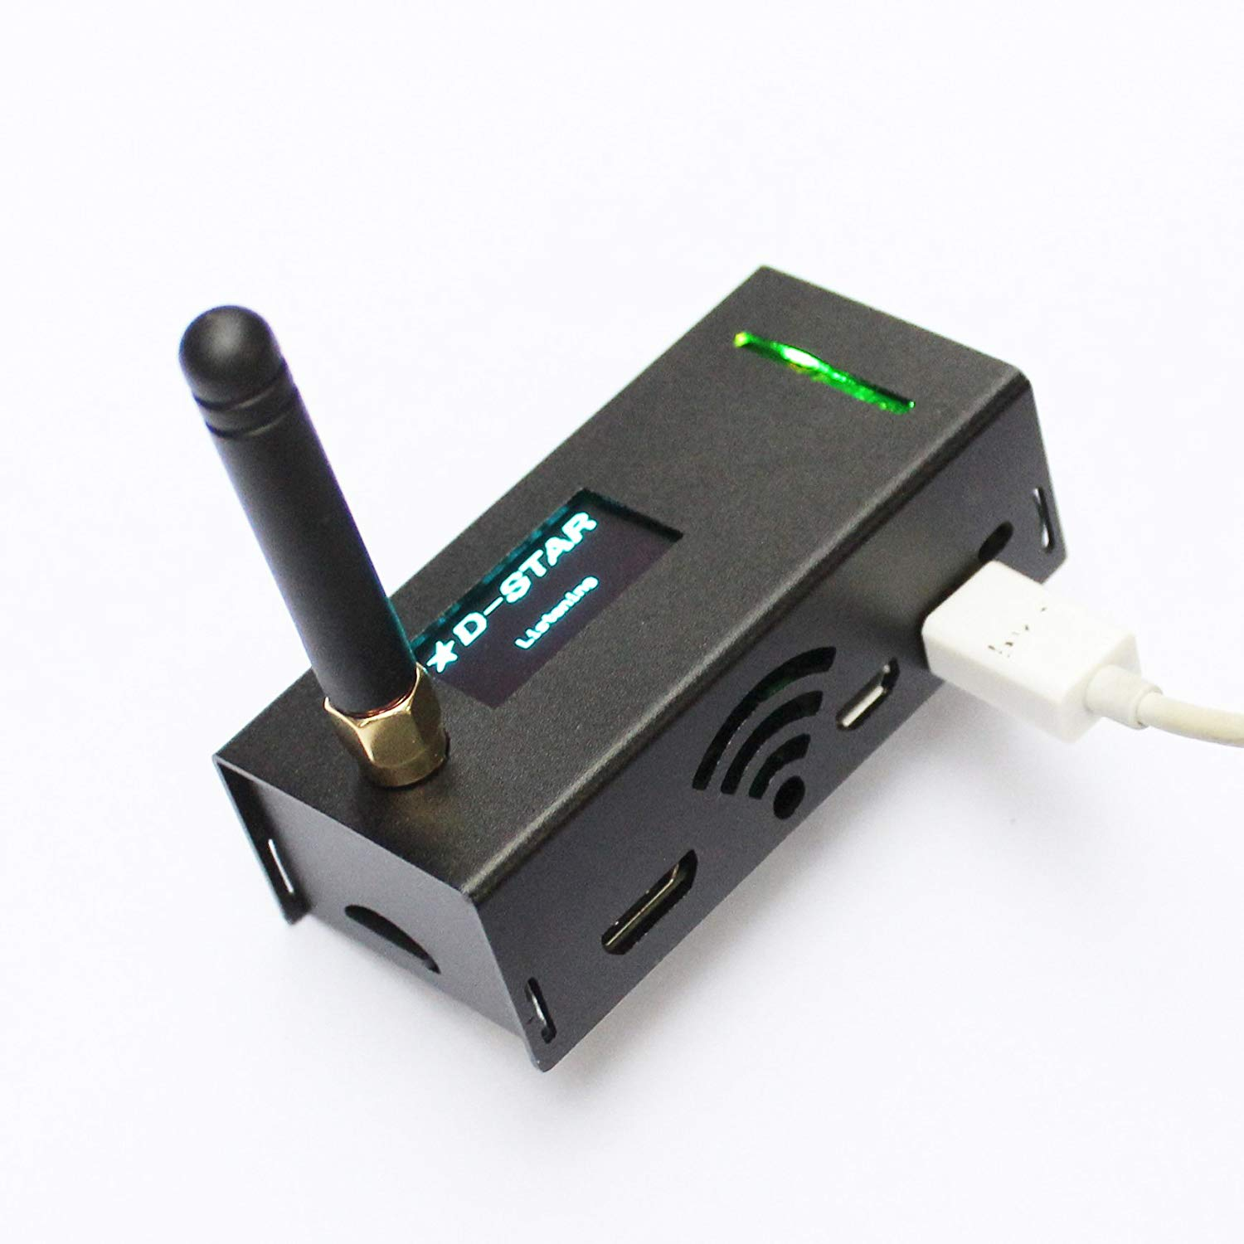
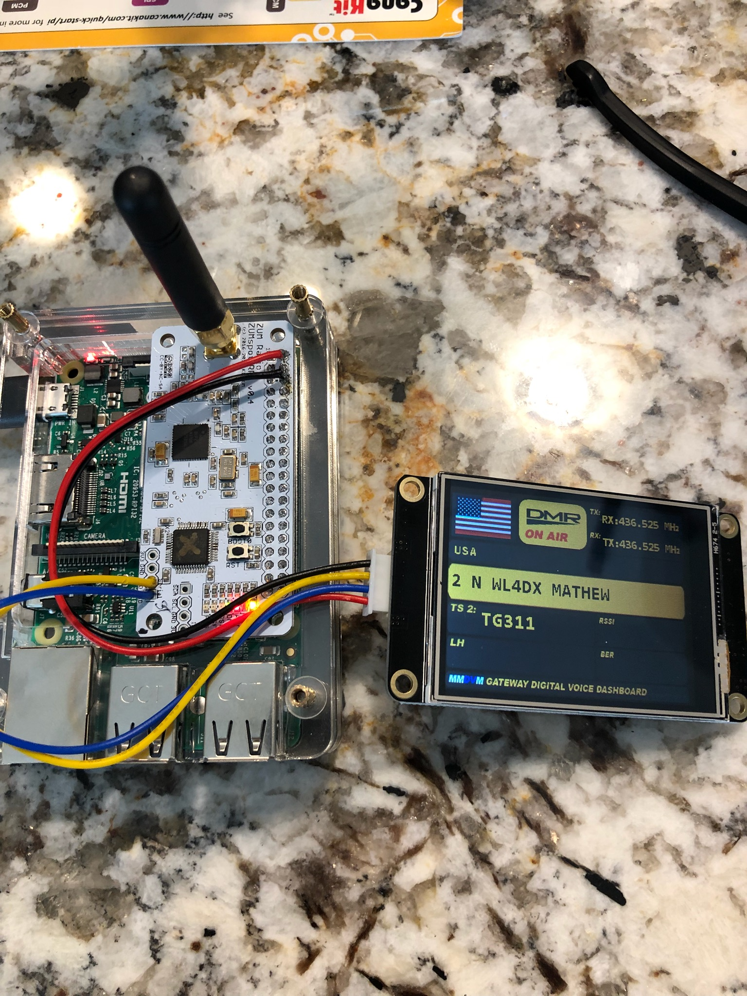
Jumbo Spot & ZOOM
Jumbo Spot ZOOM Spot With Nextion Display
E-bay = $132.00

Slide 6
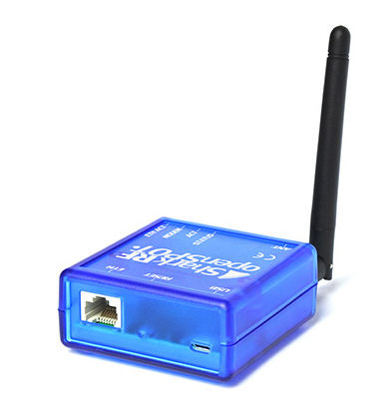

SharkRF Openspot 1 & 2
SharkRF Openspot 1 – has lights, gives voice info via TG9, but needs an adapter to do mobile Wi-Fi
Key features – SharkRF Openspot 2
Web-based easy and fast Quick Setup
No additional hardware required, works out of the box without a computer
Supports cross modem modes (example: talk with your C4FM radio on DMR, and with your DMR radio on System Fusion networks).
SharkRF Openspot 1 – Discontinued production
TP-LINK
Portable 3G/4G Wireless N Router
Model No. TL-MR3020

Slide 7
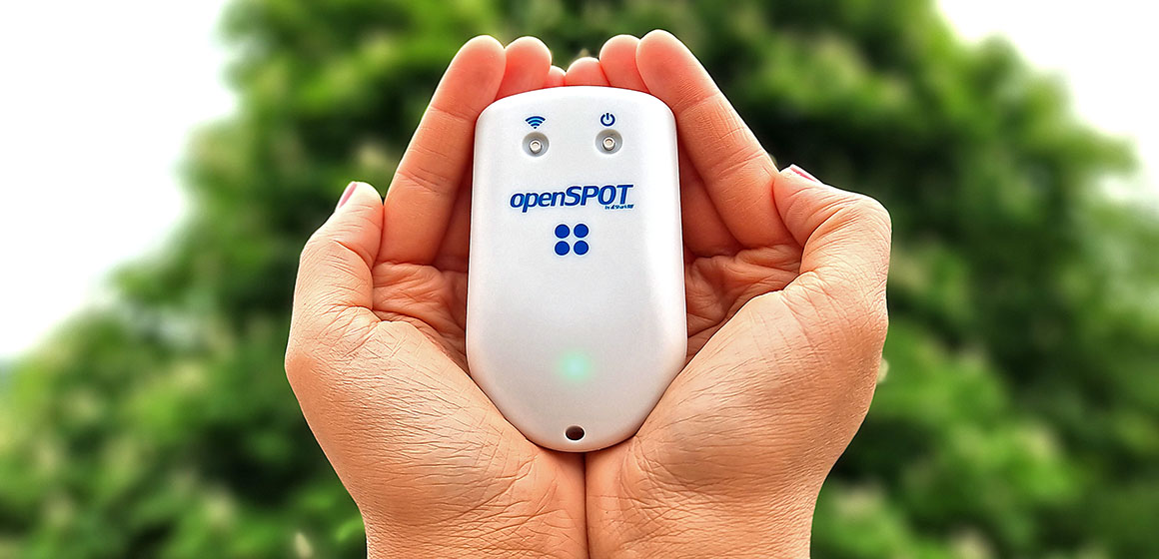
SharkRF Openspot 3 , 4 & 4Pro
Both the openSPOT4 and openSPOT4 Pro can do cross modes, however, D-STAR® cross mode operation requires the Pro version of the openSPOT4
The openSPOT4 Pro extends the feature set of the openSPOT4 with onboard transcoding hardware:
The openSPOT4 Pro has the best voice quality in cross mode operation
Supports D-STAR® cross modes: use your D-STAR® transceiver to access DMR, C4FM, NXDN® networks, or your DMR, C4FM, NXDN® transceiver to access D-STAR® networks
Supports call audio playback on the web interface
Supports 10 configuration profiles
OpenSpot 4 = $260.90
OpenSpot 4 Pro = $329.04

Slide 8
Analog RADIO’s
TYT MD-UV380 (UHF only), most popular, cheapest, and has TY Tools firmware to add features for free.
TYT MD-2017 (UHF-VHF), gaining popularity, and TY Tools coming.
TYT MD-9600 (UHF-VHF), mobile radio.
Connect Systems, Hytera, Motorola, Rfinder, and several other off brands available.
Kenwood, Icom, and Yaesu not in DMR yet.

Slide 9
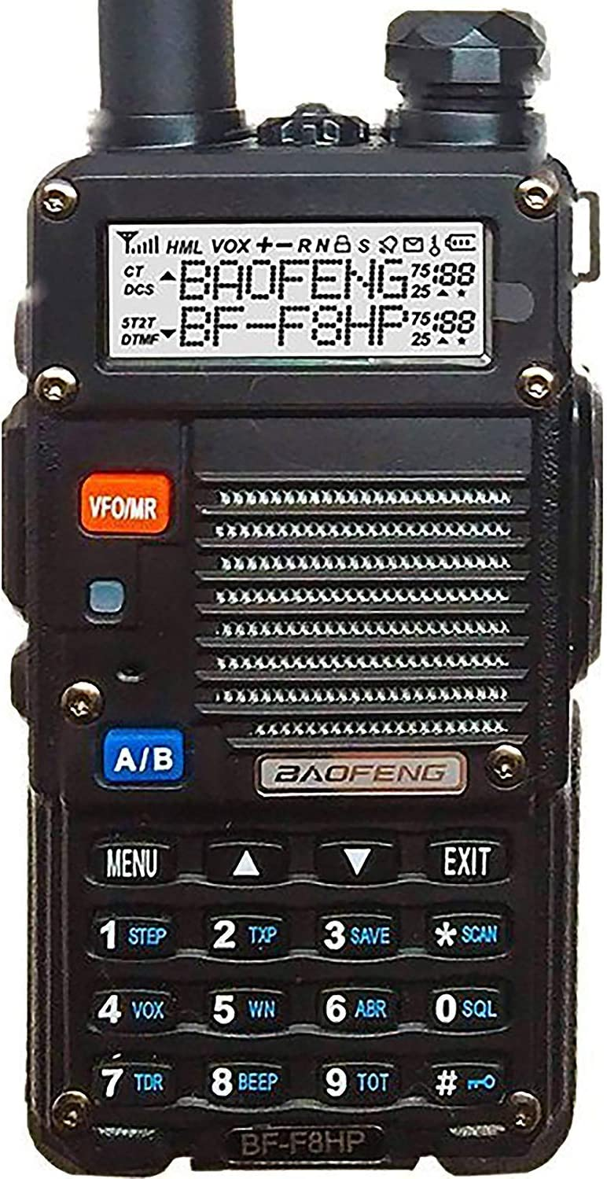
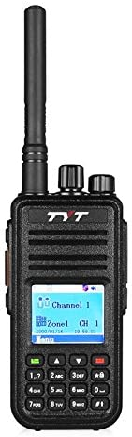
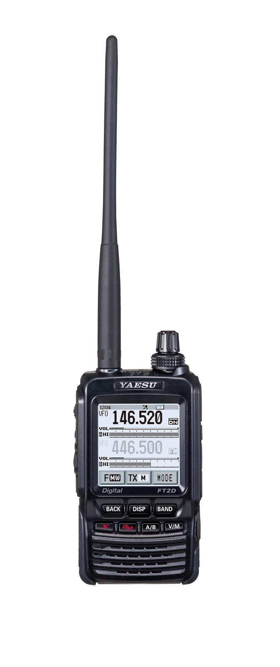
Analog HT
Baofeng MD-UV380 Yaesu FT-2D
Dual Band DMR Radio

Slide 10
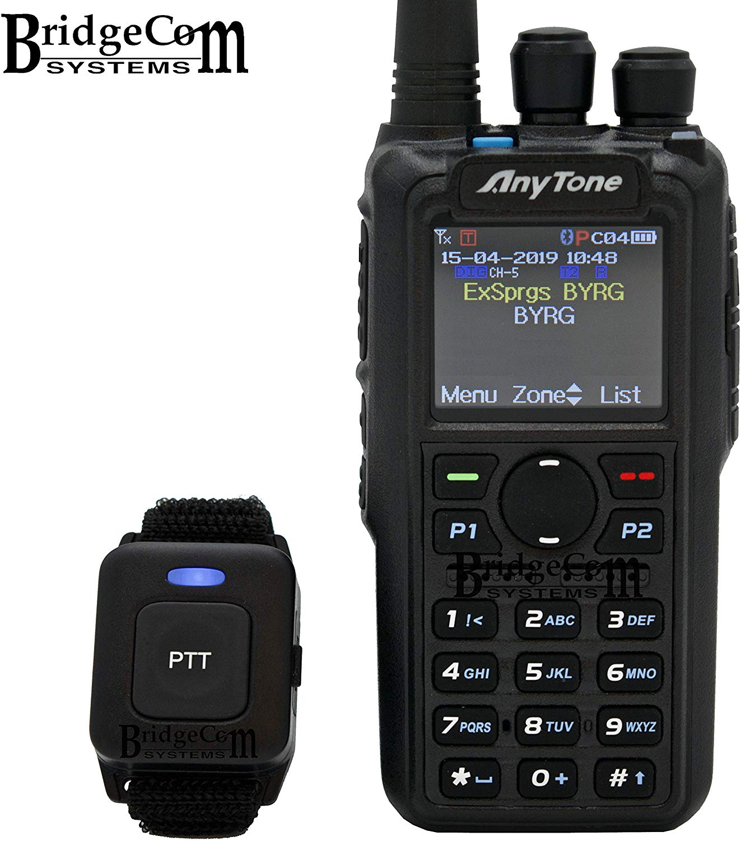
Anytone D878UVII W/Optional Blue Tooth
VHF/UHF DUAL BAND: Features both DMR digital and analog modes. DMR Tier I and Tier II operation.
Bluetooth capabilities: Hook up to your car, wireless speaker, or headphones, and talk hands-free with most of your Bluetooth audio devices.
Over 24 hours of talk time on Bluetooth PTT button
Massive Memory: 4,000 Memory Channels, 10,000 DMR Talk Groups, 200,000 Digital Contacts, 250 zones, up to 250 channels per zone.
High Power Output - 6.0W, 4.0W, 2.5W, 1.0W selectable TX power output
136-174 / 400-480 MHz RX/TX
Up to 35 hours between charges with the supplied 3100 mAh lithium-ion battery
Bandwidth 12.5 / 25.0 kHz Analog, and 12.5 kHz DMR Import/Export
$314.99

Slide 11
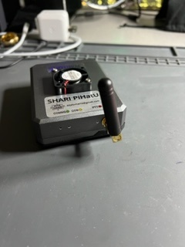
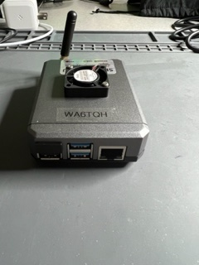
Shari PiHatU UHF or VHF Interface Assembled Shari PiHatU with optional Fan
This Pi Hat contains an SA818 Radio module to allow RF to the ALLSTAR network through a raspberry pi-4. Building project for the Shari Pi-4U Allstar node and the PiHat node for the Raspberry Pi-4. Purchased from www.hamprojects.info

Slide 12
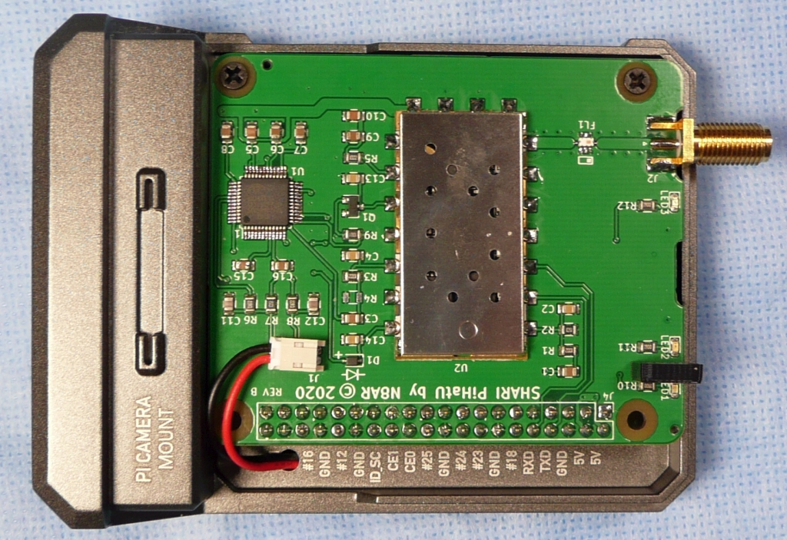
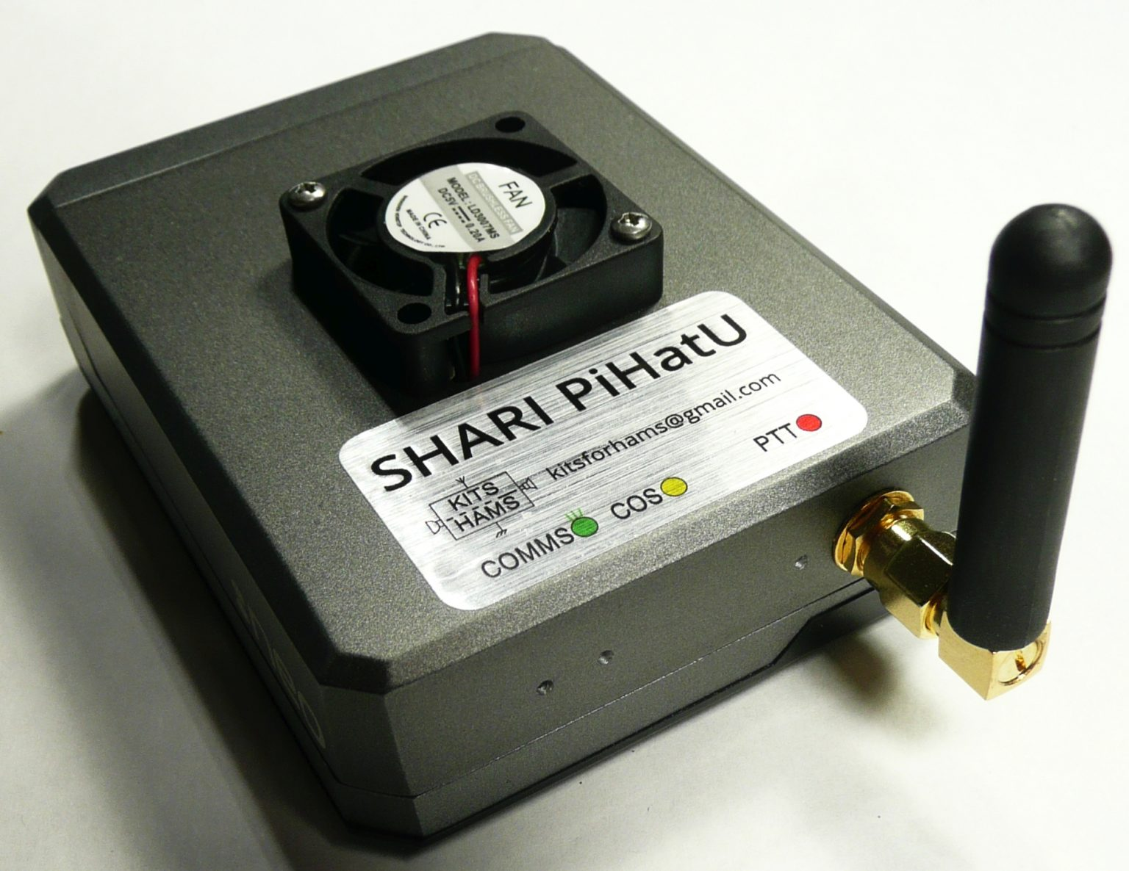
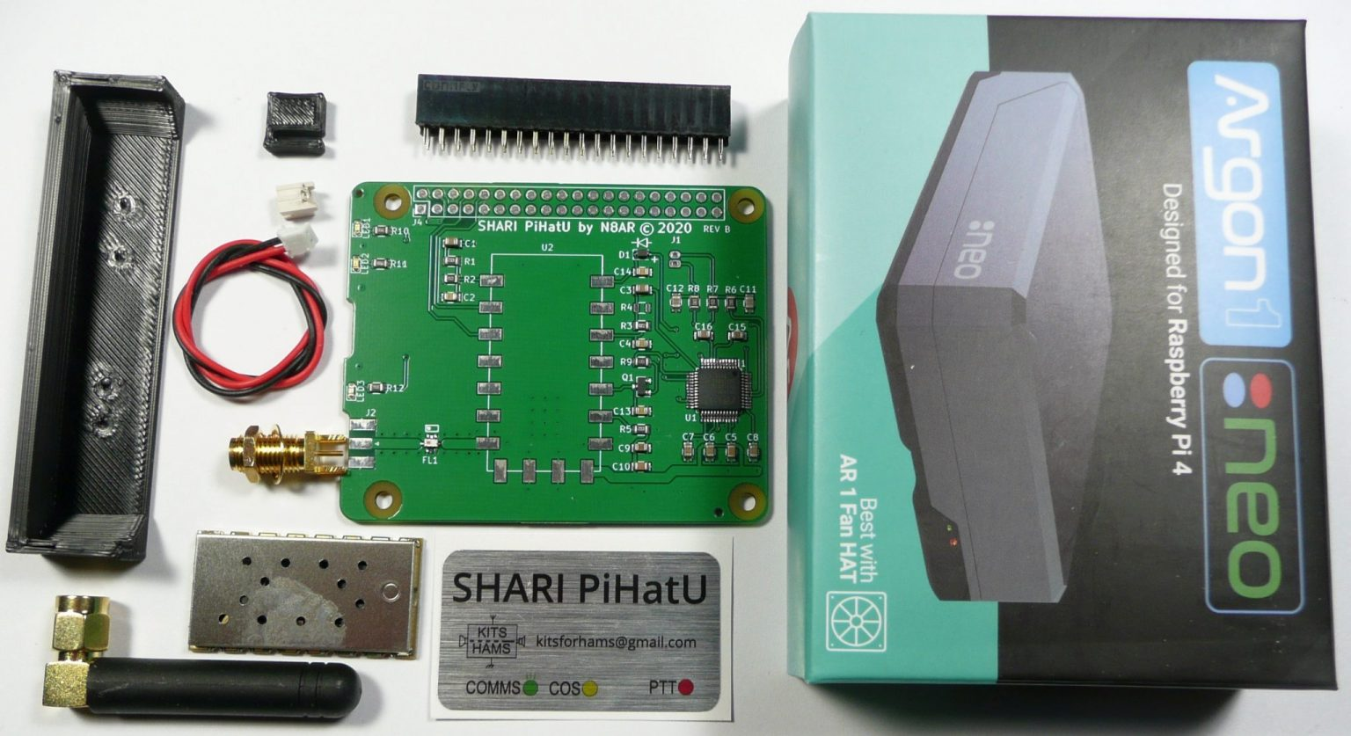
Kit: $84.00
Purchaser provides Pi-4
Fan Extra see Amazon
Fully Assembled: $195
Includes Pi-4 & programming
SHARI (SA818 Ham Allstar Radio Interface) UHF or VHF Interface
SHARI (SA818 Ham Allstar Radio Interface) PiHat is a ham construction project designed by N8AR that implements a Raspberry Pi hosted Allstar node in single Neo enclosure using a NiceRF SA818 embedded UHF (420 – 450 MHz) or VHF (144-148 MHz) radio module. SHARI PiHat is designed as a kit.

Slide 13
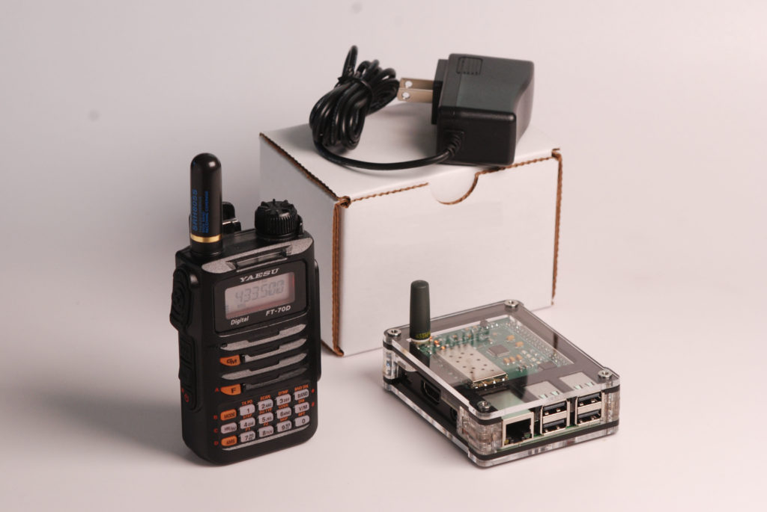
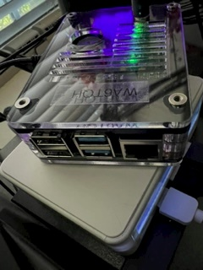
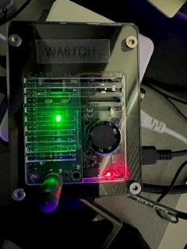
ClearNode UHF or VHF Digital Modes
ClearNode is a pre-configured Raspberry Pi-4 based AllStar, EchoLink & Digital Modes simplex node with an integrated low power UHF (or VHF) FM radio transceiver. Digital modes now include DMR, P25, YSF, FCS and NXDN. Available at www.node-ventures.com/buy-clearnode/
ClearNode includes a free companion iPhone and Android mobile app to Setup and Control your node – from anywhere you have an internet connection. Available on Google Play Store or iPhone App Store.
You can also control your node connections using DTMF commands from your handheld radio.

Slide 14
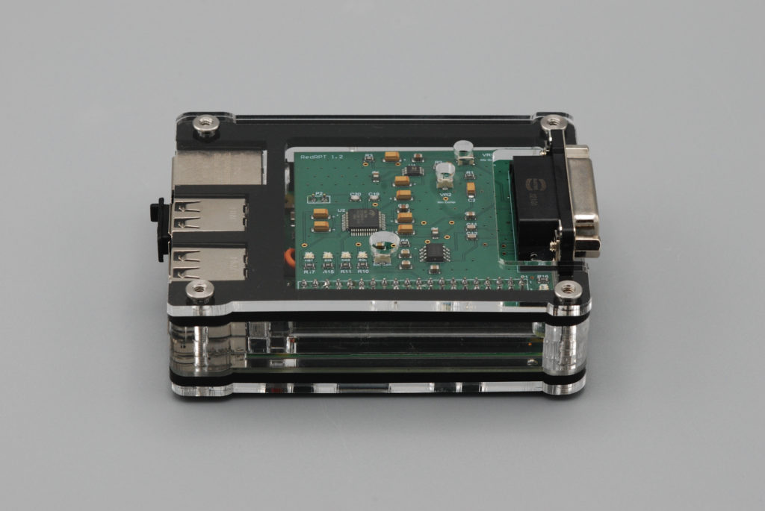
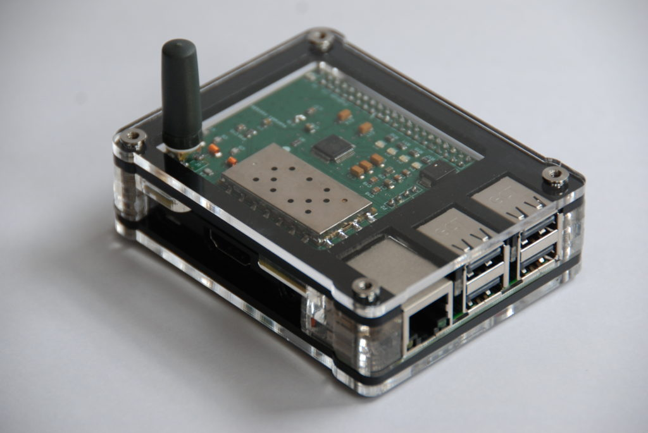
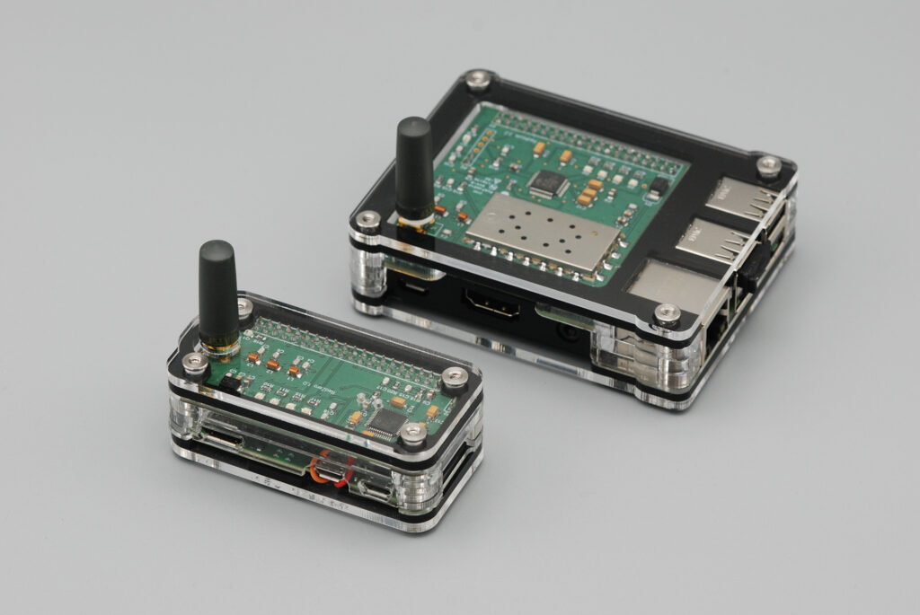
ClearNode Optional Configuration
ClearRPT – Combo = $650 ClearNode = $345 ClearZero*
ClearRPT does NOT have an embedded RF transceiver but provides electrical connections for audio in and out, PTT, SQ and numerous Raspberry Pi GPIO pins. ClearRPT also includes a microphone conditioning circuit and a 2.5W Class D audio amplifier for an external speaker or headset.
ClearZero sports all the access node functionality of the original ClearNode – in a much smaller package – 3 x 1.5 x 1 inches – not much bigger than a box of matches !
*It doesn’t look like there will any supply of the Raspberry Pi Zero 2 W until, at least, the 1st half of 2023 – and that’s only if the chip supply chain “recovers” within that time frame.

Slide 15
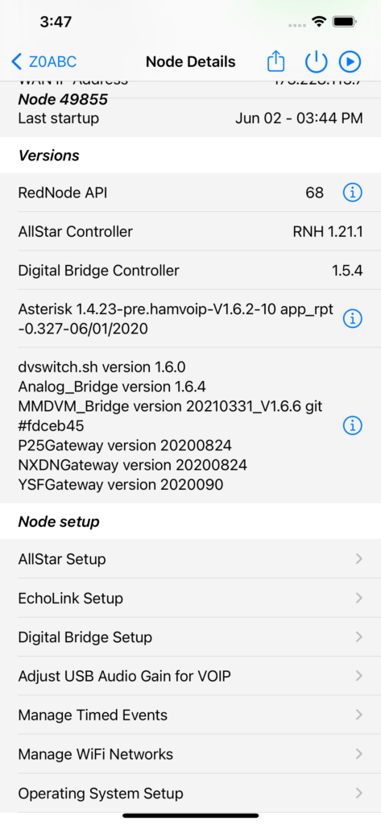
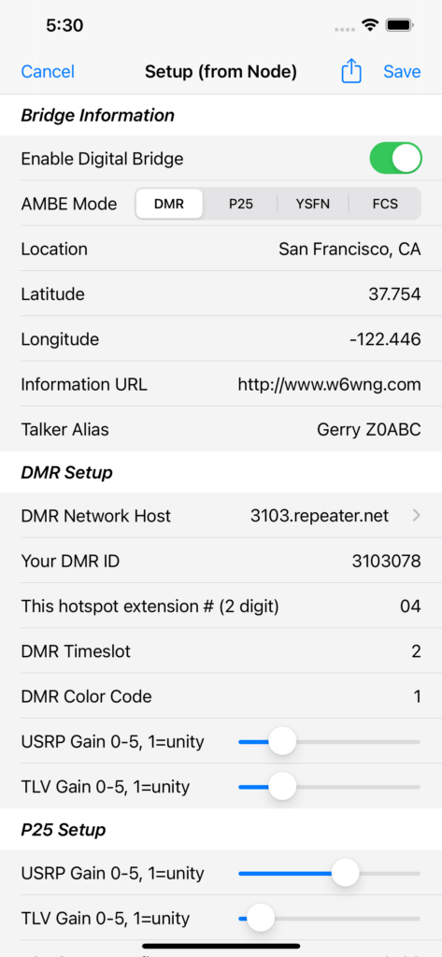
ClearNode Mobile Application
The ClearNode Mobile App allows you to:
Configure your AllStar, EchoLink & Digital credentials and settings
Configure your ClearNode WiFi credentials without using SSH and Terminal
Connect and disconnect your ClearNode from remote nodes, hubs, reflectors and Talk Groups
Automate your connects and disconnects with calendar Timed Events
Keep, edit and tag a catalog of the nodes you regularly connect to
Control the integrated radio: Tx/Rx frequency, CTCSS/DCS codes, Squelch, Volume …
Power down or reboot your ClearNode
Play a delayed stream (~20 sec) of the audio traffic on your ClearNode on your mobile device
Update the software revisions running on your ClearNode
Find your ClearNode’s current LAN/WAN IP Address
Control multiple AllStar & Echolink ClearNodes

Slide 16
Internet Access Requirements
ClearNode requires:
Configuring the router for static IP
Echolink Requires
Allow UDP destination ports 5198-5199 between Internet and EchoLink node in both directions Forward UDP 5198-5199 to your EchoLink node Allow TCP (source port any, destination port 5200) from EchoLink node to Internet
Addresses that ClearNode requires: (Sometimes blocked by Service Provider)
apps.gerf.com
dl.hamvoip.org
a1alhl42uei0bn.iot.us-west-2.amazonaws.com

Slide 17
Known AT & T Issues
Manage your network using Smart Home Manager from your PC.
My router AT & T Model: BGW320-500 (High Speed Fiber)
Login to your personal AT & T account.
Then search for “Mange your network”
Then search for “Smart Home Manager”
Login to “Smart Home Manager”
Select “ATT Internet Security”
Look for “Security Exceptions” You should see a list of ALL exceptions.
Select the one’s you want to UNBLOCK

Slide 18
DMR Technical Assistance
If you need any help outside of the workshop sessions, you can find help here:
Contact Walter Holmes K5WH on ZOOM.
Amsat Talk Group – (98006) – Access this Amsat TG using your Hotspot
NARS Talk Group – (3146211) Access this TG using your Hotspot
Klein Local DMR Repeater – Direct Access
Cypress Local DMR Repeater – Direct Access
To use the local DMR repeater do the following:
Go to ZONE – Select Zone List – Select Klein TX – turn dial NARS TG
Go to ZONE – Select Zone List – Select Cypress TX – turn dial to NARS TG

Slide 19
Questions
If you have interest in becoming more active on the Digital modes, be sure to contact one of our Elmer’s or go onto Walters K5WH Zoom Channel which is available daily. (281 543 6502 PC: 123456)
We also have weekly Nets:
VHF/UHF Net every Wednesday evening 8PM.
Also linked via EchoLink node W5NC-R or ALLstar
146.66 pl 100
444.375 pl 100
DMR Net every Tuesday evening 7PM
Talk Group = 3146211 Color = 1 TS = 2

