Slide 1

WSJT-X FT8 JS8Call
An Introduction

Slide 2
What is WSJT-X?
WSJT-X is software that implements communication protocols or "modes" called FT8, JT4, JT9, JT65, QRA64, ISCAT, MSK144, and WSPR, as well as one called Echo for detecting and measuring your own radio signals reflected from the Moon. These modes were all designed for making reliable, confirmed QSOs under extreme weak-signal conditions.
Written by K1JT (Weak Signal Joe Taylor – WSJT)
First released in 2001
Download: https://physics.princeton.edu/pulsar/k1jt/wsjtx.html

Slide 3
What is WSJT-X?
The current release of WSJT-X is version 2.0.1
New FT8 and MSK144 protocols with 77-bit payloads permit these enhancements:
Optimized contest messages for NA VHF, EU VHF, Field Day, RTTY Roundup
Full support for "/R" and "/P" calls in relevant contests
New logging features for contesting
Integration with N1MM Logger+ and Writelog for contesting
Improved support for compound and nonstandard callsigns
Nearly equal (or better) sensitivity compared to old protocols (-30db)
Lower false decode rates
Improved color highlighting of received messages
Improved WSPR sensitivity
Expanded and improved UDP messages sent to companion programs

Slide 4
What is WSJT-X?
The current release of WSJT-X is version 2.0.1
Note that for FT8 and MSK144 there is no backward compatibility with WSJT-X 1.9.1 and earlier. Everyone using these modes should upgrade to WSJT-X 2.0 by January 1, 2019.
Timing is EVERYTHING!!!!!

Slide 5
What is Dimension 4?
Windows time service is not accurate enough
Dimension 4 uses a low level internet protocol, called SNTP, to connect with special purpose Internet Time Servers that have been keeping the rest of the web on-time for the last 20+ years. These time servers typically have direct access to their very own time source, or they are connected directly to other Internet Time Servers that do.
Download: http://www.thinkman.com/dimension4/download.htm

Slide 6
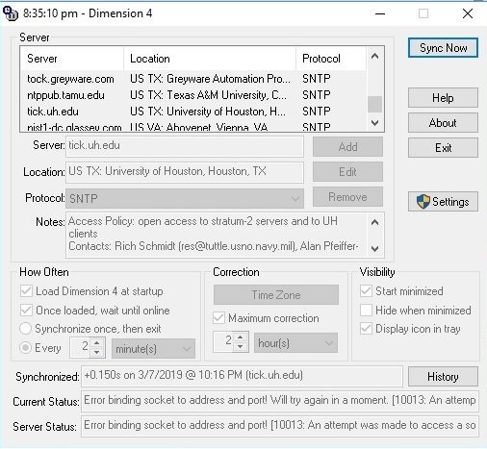
What is Dimension 4?
Dimension 4
Sync every few minutes

Slide 7
What is FT8?
FT8 stands for "Franke-Taylor design, 8-FSK modulation" and was created by Joe Taylor, K1JT and Steve Franke, K9AN. It is described as being designed for "multi-hop Es where signals may be weak and fading, openings may be short, and you want fast completion of reliable, confirmable QSO's".
Great for DXCC, WAS, and any awards type contacts
Transmit for 12.6 seconds and decode for 2.4 seconds
Your computers clock MUST be set correctly! Dimension 4!

Slide 8
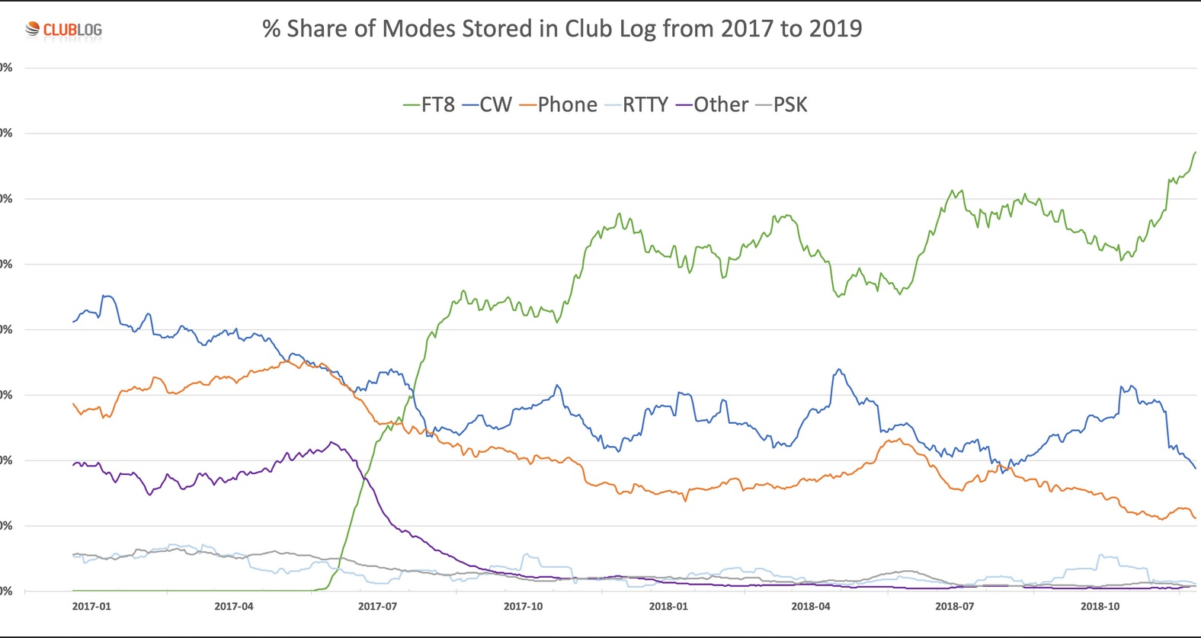
What is FT8? Increased Activity (N5BA)

Slide 9
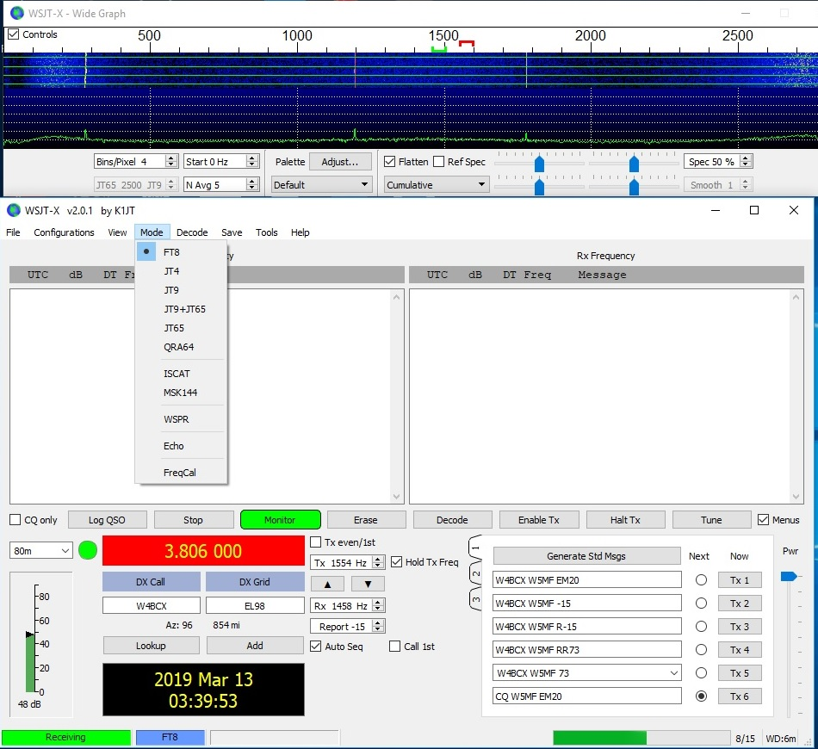
What is FT8?
FT8 application

Slide 10
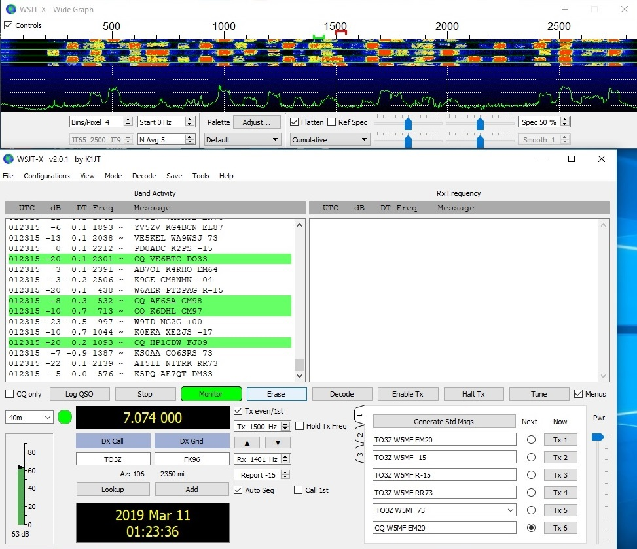
What is FT8?
FT8 application
Waterfall at top
All stations on left
Current rec frequency on right. See green bracket in water fall. Red bracket in water fall is transmit.

Slide 11
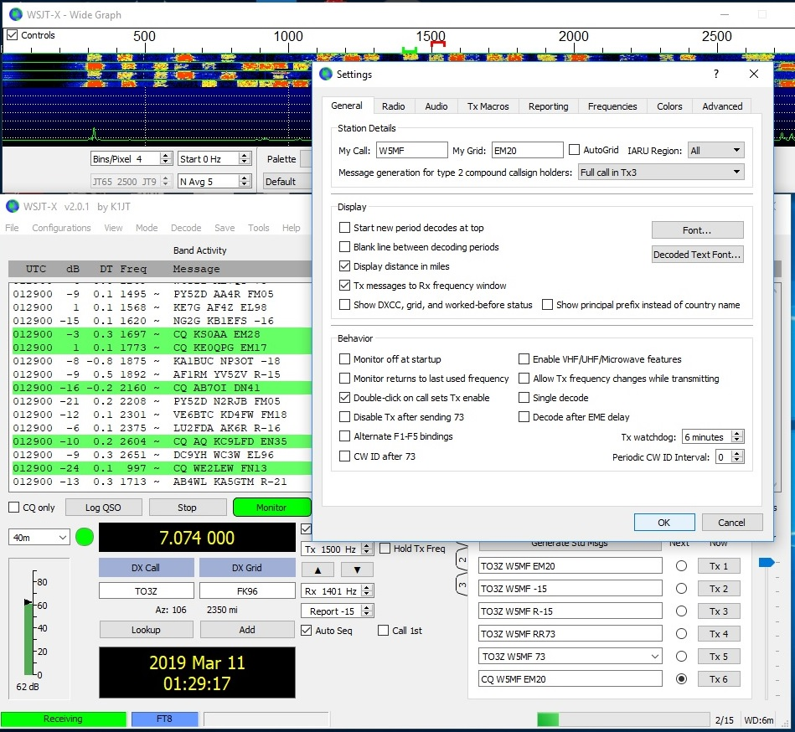
What is FT8?
FT8 application
File→Settings
General
Check Double Click

Slide 12
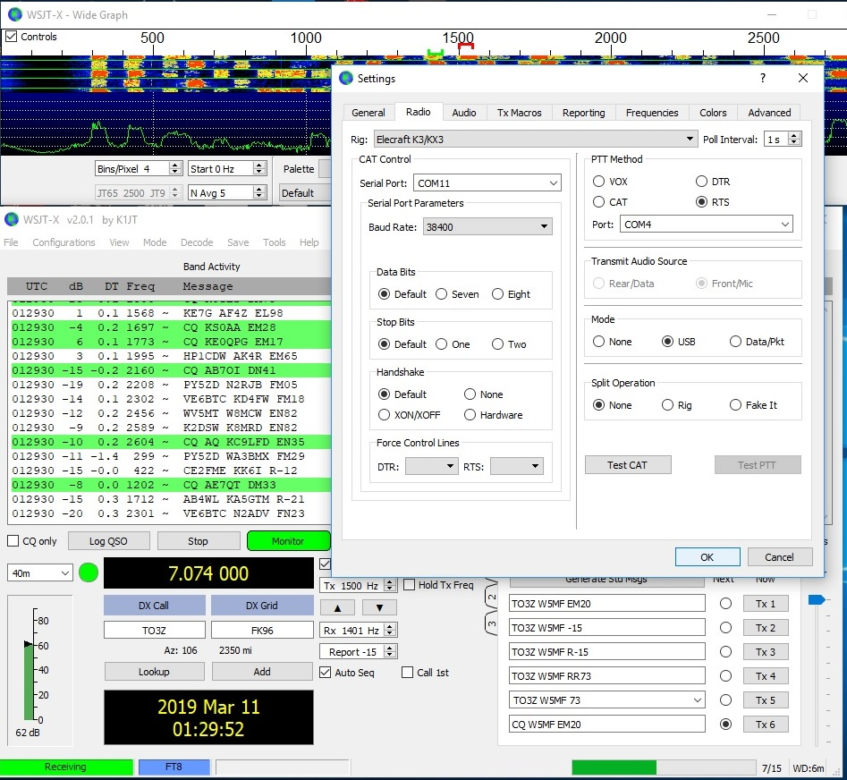
What is FT8?
FT8 application
File→Settings
Radio configuration

Slide 13
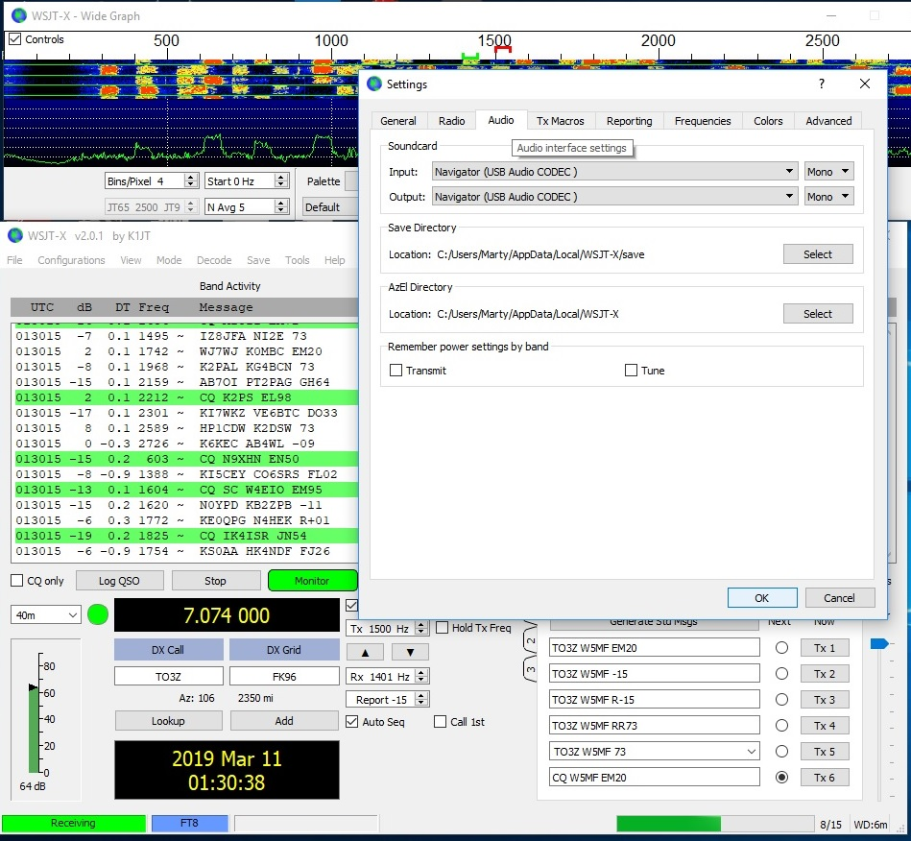
What is FT8?
FT8 application
File→Settings
Audio Configuration

Slide 14
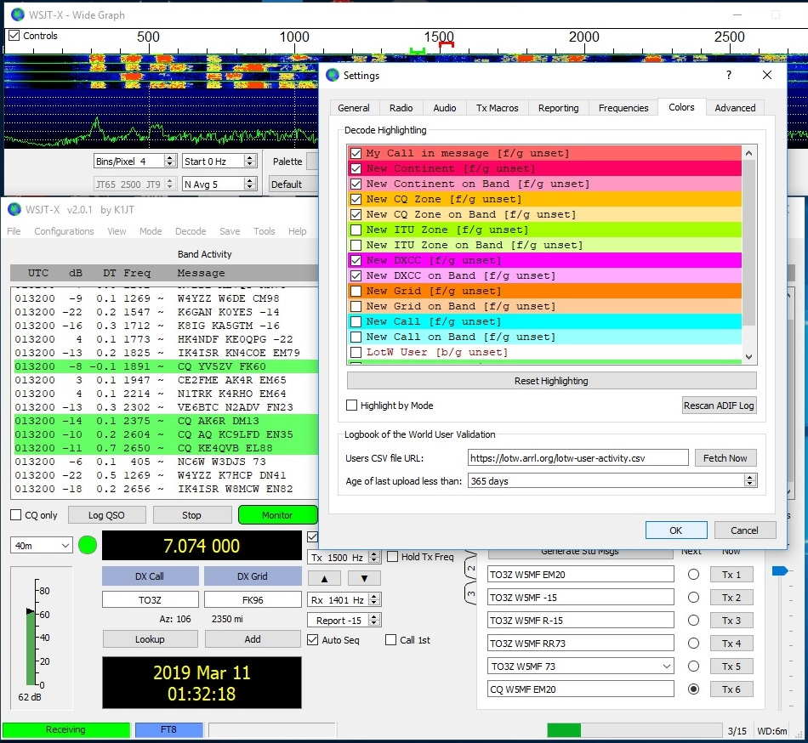
What is FT8?
FT8 application
File→Settings
Color Configuration

Slide 15
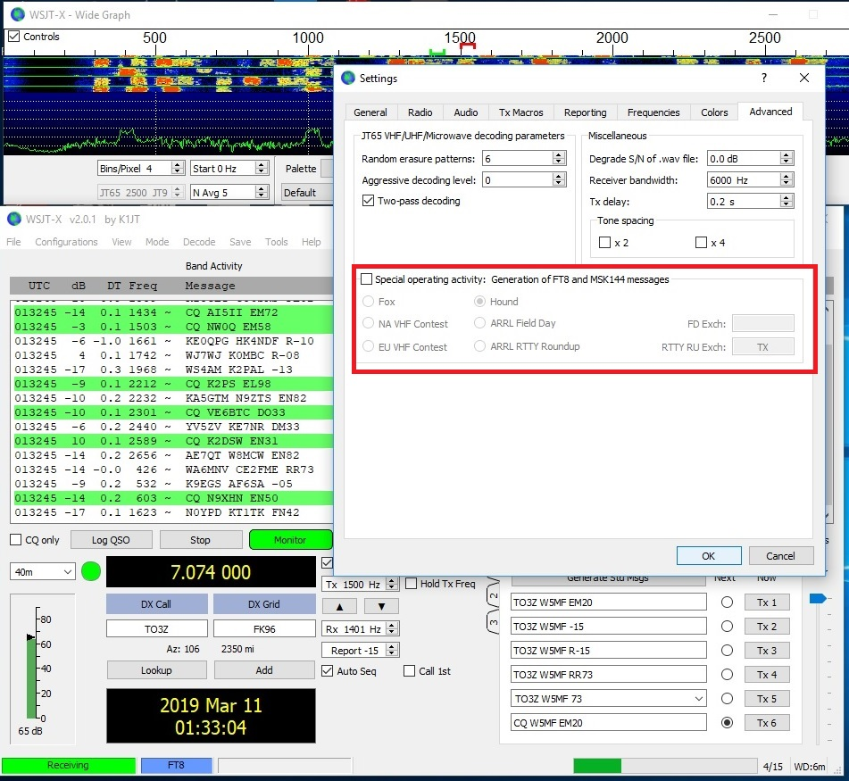
What is FT8?
FT8 application
Advanced
Special operating activity
Contesting
DX Expedition mode also known as Fox-Hound

Slide 16
What is FT8?
FT8 application
DX Expedition mode also known as Fox-Hound
DXpedition station (the fox) and their callers (the hounds). A single fox transmitter can now generate multiple FT8 signals simultaneously, making multiple QSOs in parallel on one rig and band.
Add DXpedition FT8 frequencies to the frequency table e.g. 14.090 (not the usual FT8 frequencies!) under F2 Settings → Frequencies. Right-click the table, then insert the DXpedition FT8 frequencies. Leave the usual FT8 frequencies alone (it’s OK to have multiple FT8 frequencies on each band - set up a separate configuration for DXpeditions if that helps).

Slide 17
WSJT-X
WSJT-X add on applications
WSJT-X JT Alert https://hamapps.com/
Grid Tracker https://tagloomis.com/grid-tracker/

Slide 18
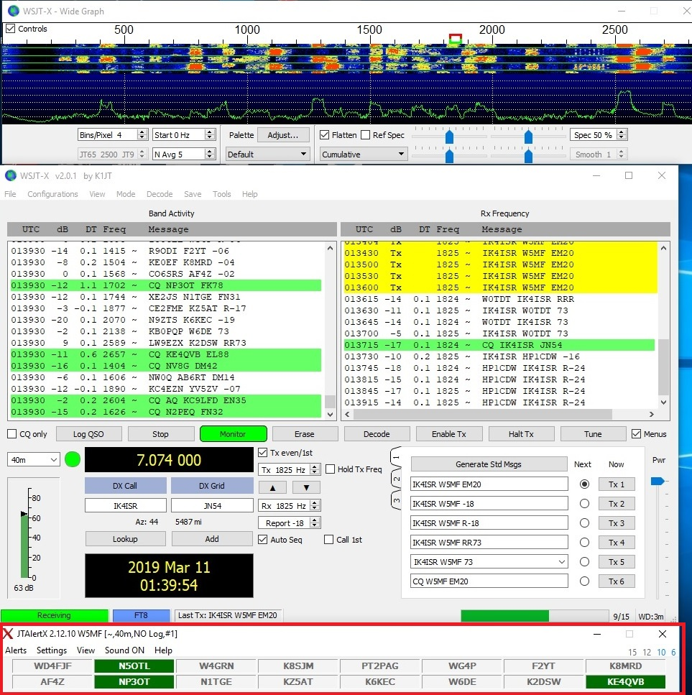
WSJT-X
WSJT-X JT Alert

Slide 19
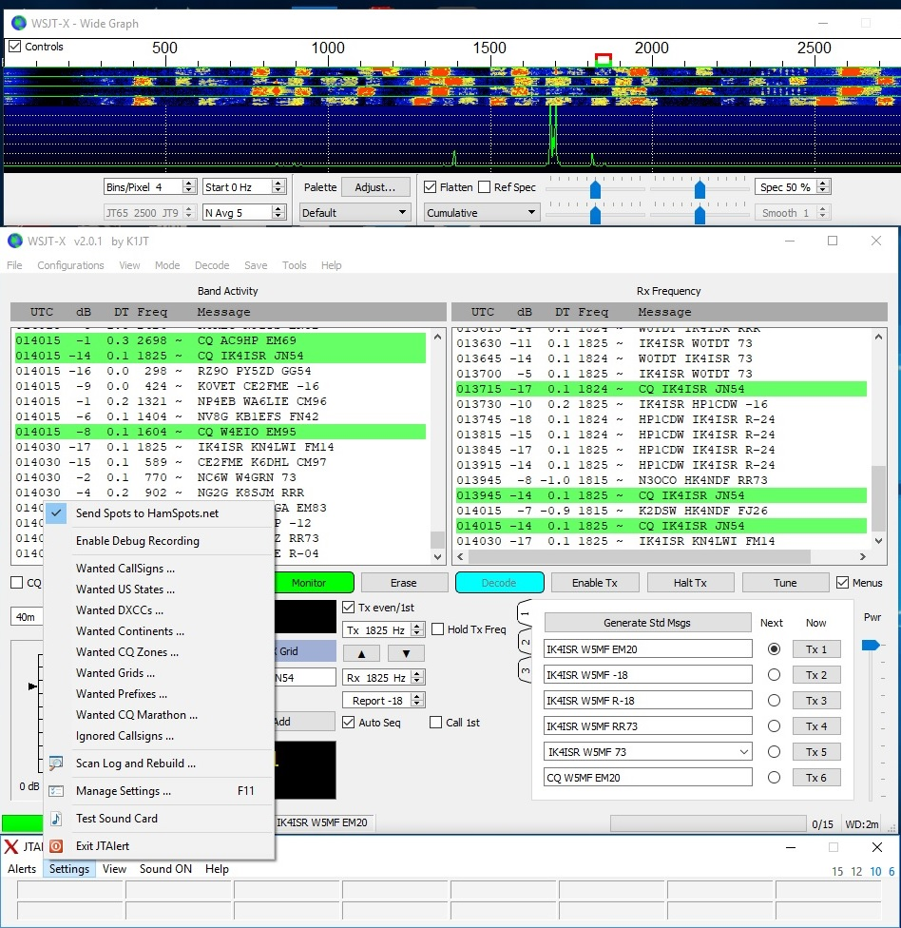
WSJT-X
WSJT-X JT Alert

Slide 20
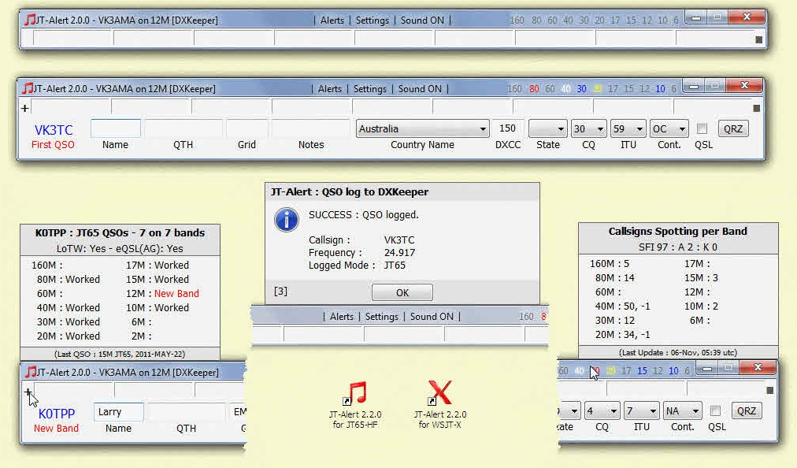
WSJT-X
WSJT-X JT Alert

Slide 21
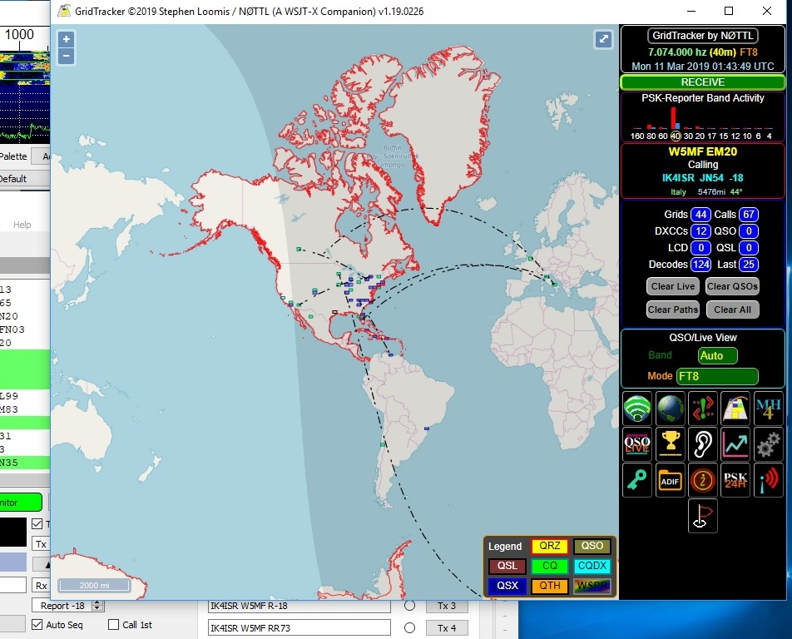
WSJT-X
Grid Tracker
Can only run JT Alert or Grid Tracker

Slide 22
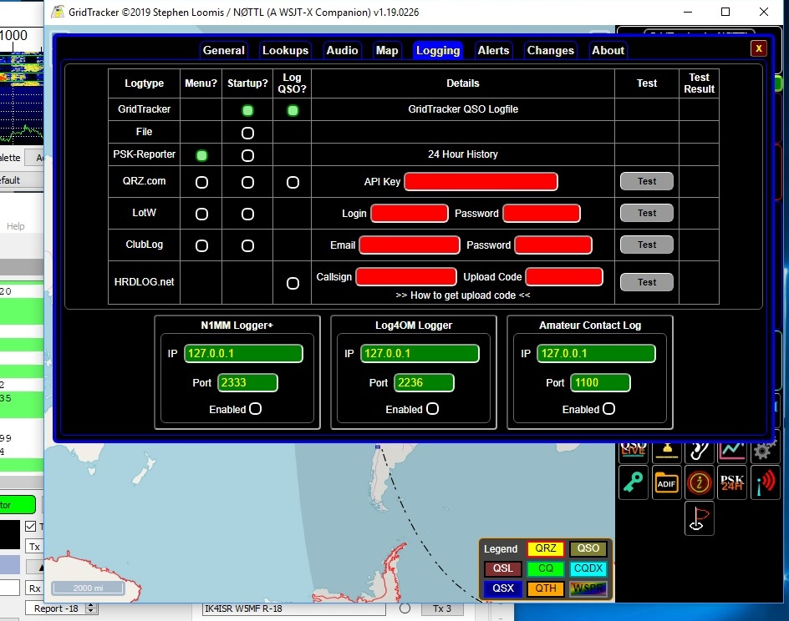
WSJT-X
Grid Tracker
Settings →Logging

Slide 23
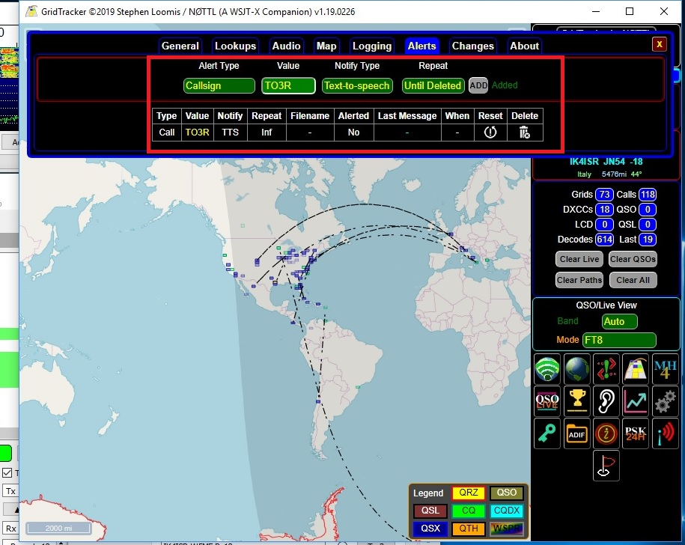
WSJT-X
Grid Tracker
Settings → Alerts

Slide 24
What is FT8?
FT8 Live Demo

Slide 25
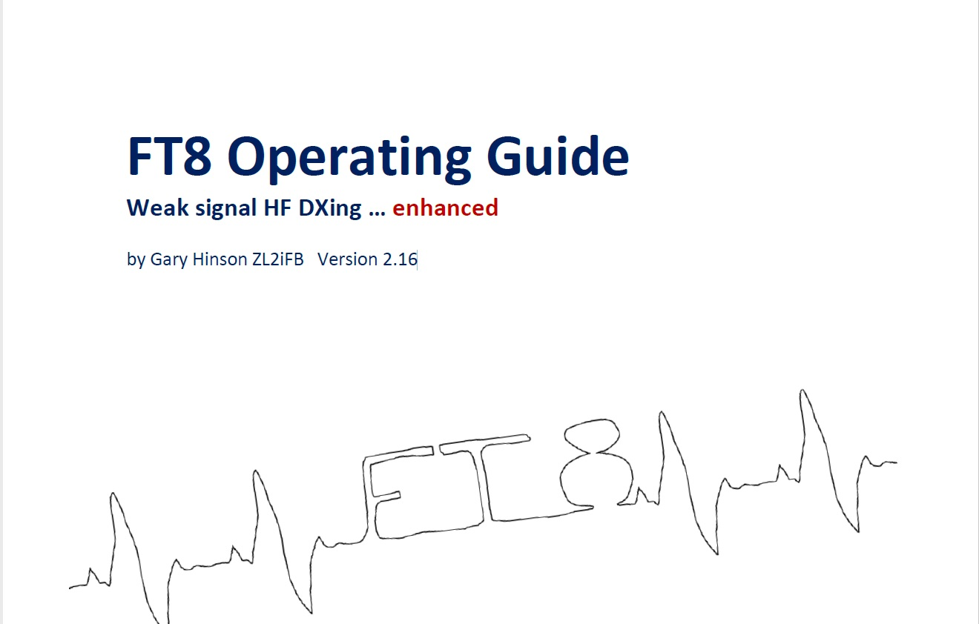
What is FT8?
FT8 More Info
Google ZL2IFB

Slide 26
What is JS8 Call?
JS8 Call is an experiment to test the feasibility of a digital mode with the robustness of FT8, combined with a messaging and network protocol layer for weak signal communication on HF, using a keyboard messaging style interface. It designed for connecting amateur radio operators who are operating under weak signal conditions.
JS8Call uses a custom FT8 modulation called JS8 (Jordan Sherer KN4CRD designed 8-FSK modulation). This is the base RF transport. There is a “directed calling” protocol laid over top the base RF transport to support free-form and directed message passing. Hence JS8 + Directed Calling = JS8Call. And in case you didn’t get that:
JS8 is the mode
JS8Call is the software
https://groups.io/g/js8call

Slide 27
How does JS8 Call work?
JS8Call transmits in 15 second transmission “frames”
Highly compressed textual data is transmitted in back-to-back frames
Software stitches everything back together into a communication stream
“Directed commands” can be sent to instruct stations in the network with automatic replies to things like:
  What is my SNR?
  What is your GRID?
  Please relay this message to JY1

Slide 28
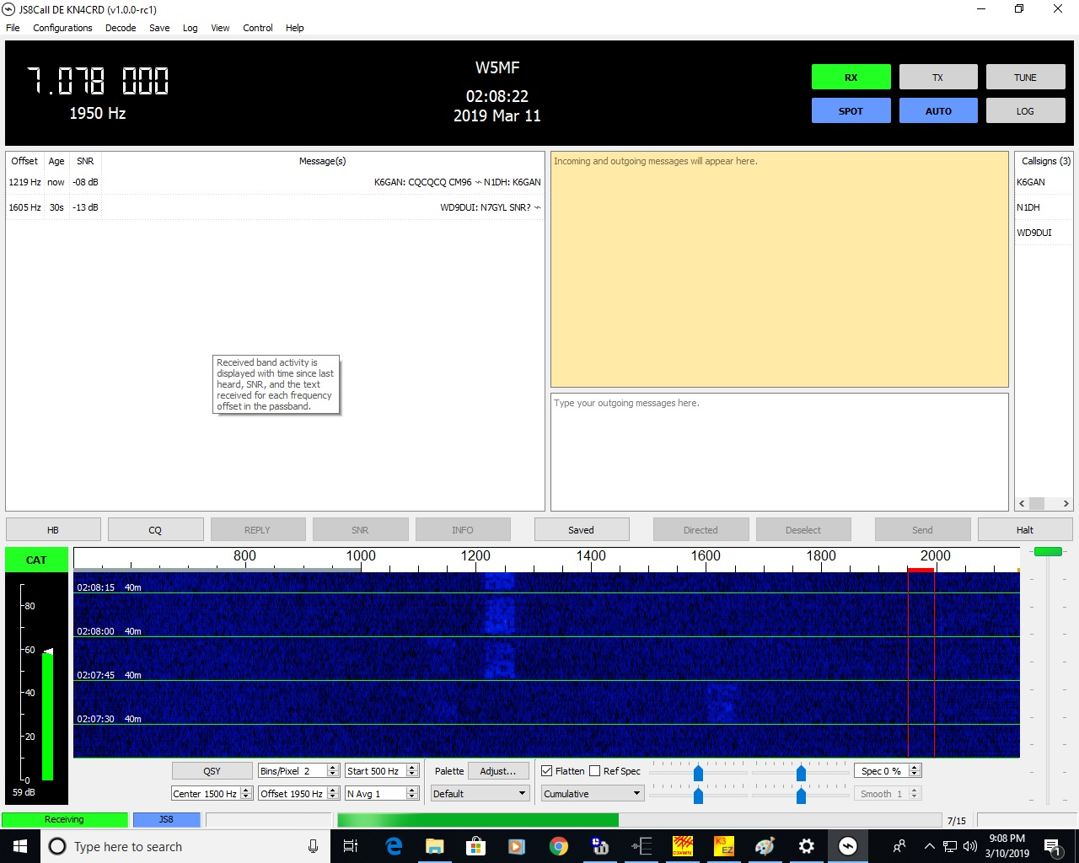
What is JS8 Call?
JS8 Call

Slide 29
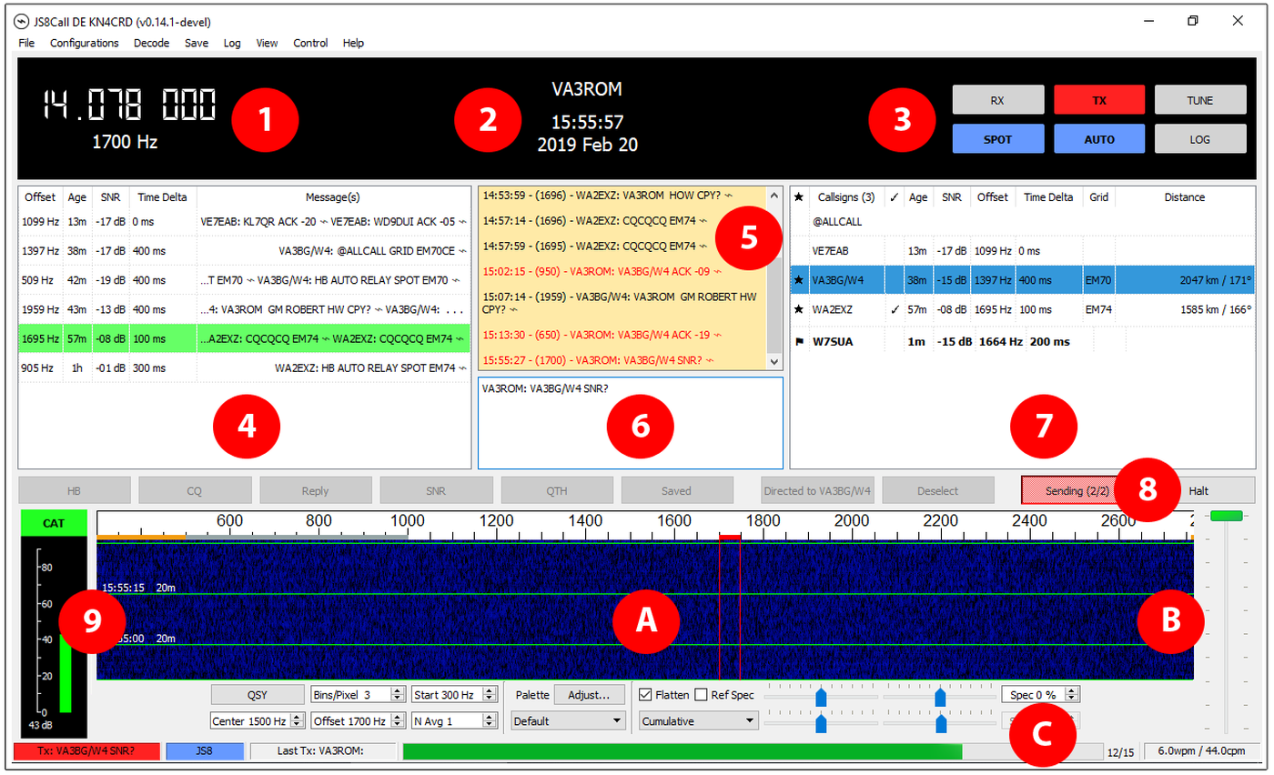
What is JS8 Call?
1. Transmitter’s dial frequency (carrier) and base audio tone offset added to carrier (all additional tonal shifts are up).
2. Station identification with current computer UTC time/date.
3. Various user selectable transceive control functions/features.
4. Signal decoding monitor.
5. Receive message buffer.
6. Transmit message buffer.
7. Stations heard with their basic information.
a. A flag next to a station call indicates a stored message from it is waiting for you in your message inbox.
b. A star next to a station call indicates that it and you hear the other.
c. A checkmark next to a station call indicates that you’ve logged a prior two-way contact on the current JS8 frequency/band with it.

Slide 30
What is JS8 Call?
8. Transmit “macro” buttons (become active and inactive, as required).
9. Signal strength and computer aided transceiver (CAT) control status.
A. Signal waterfall monitor and various settings. The grey area between 500 to 1000 hertz (Hz) is reserved for “heartbeat” (HB) beacons and any replies from JS8 stations hearing them, or replies to station queries. Bottom 500 Hz (orange area) is the JT65 data mode sub-band. Do NOT transmit JS8 normal communications below 1000 Hz unless absolutely necessary (must change default station setup option allows this). The idea is to separate normal KB-KB activity from specific JS8Call features not available in other data modes but minimize inter-mode interference with other data modes including JS8.
B. Transmitter output audio tone level slider adjustment.
C. Current and past transceive activity status.

Slide 31
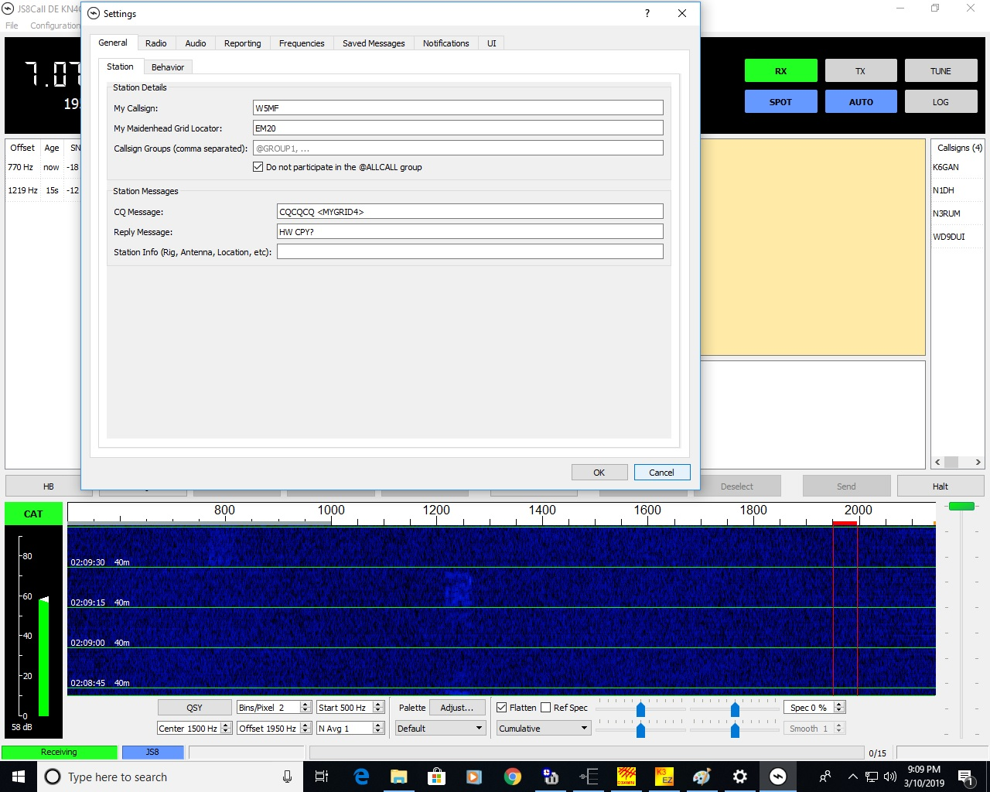
What is JS8 Call?
JS8 Call
Settings

Slide 32
What is JS8 Call?
JS8 Call
More information coming
By Robert C. Mazur, VA3ROM
va3rom@gmail.com

Slide 33
What is JS8 Call?
JS8 Call Video

Slide 34
What is JS8 Call?
JS8 Call Live Demo

Slide 35
Presentation by W5MF?
Acknowledgements – Information from the following authors:
Joe Taylor K1JT
Steve Franke K9AN
Jordan Sherer KN4CRD
Robert C. Mazur VA3ROM
Brian Derx N5BA

Slide 36
Presentation by W5MF?
Questions?

