Slide 1
Satellite Operations
Walter Holmes walterh@k5wh.net
K5WH

Slide 2
Areas to cover
Typical ground station requirements
Most popular radios
Most popular antennas
Most popular digital interfaces
Most popular software
Different modes of operation
How to get involved
Important Links

Slide 3
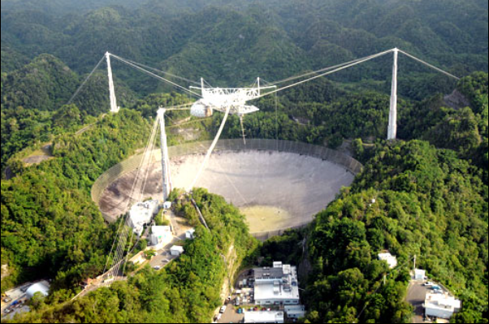
Typical ground station requirements

Slide 4
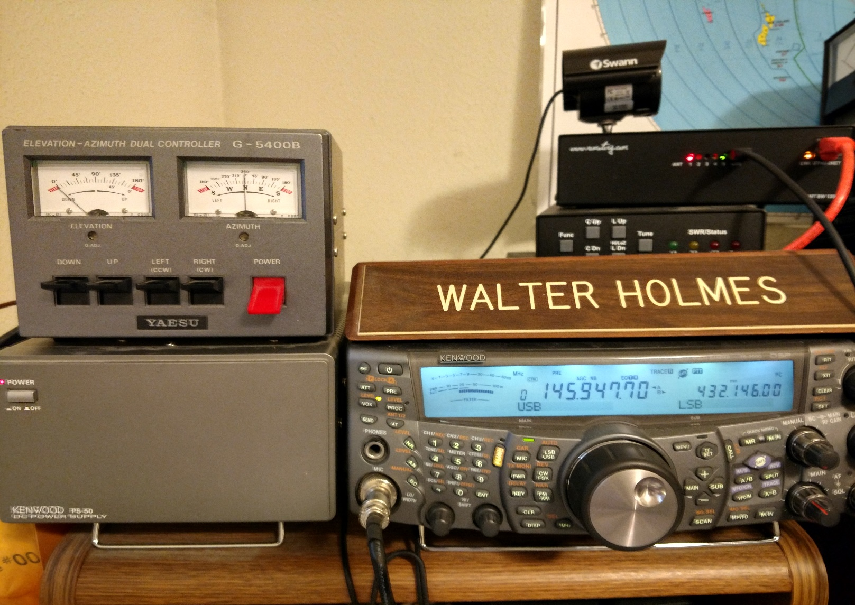
automated satellite station

Slide 5
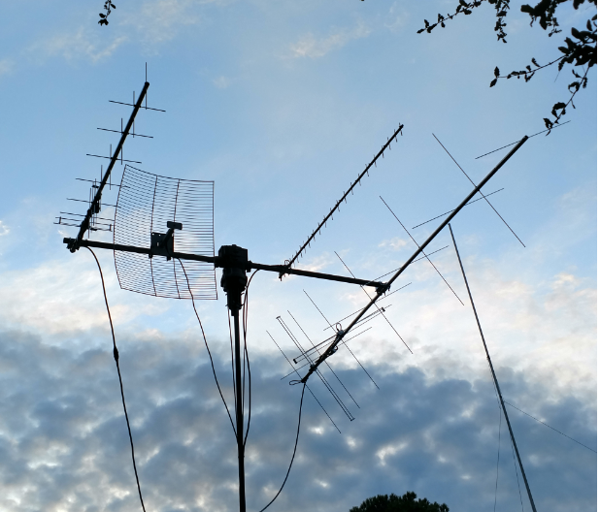
Multiband coverage

Slide 6
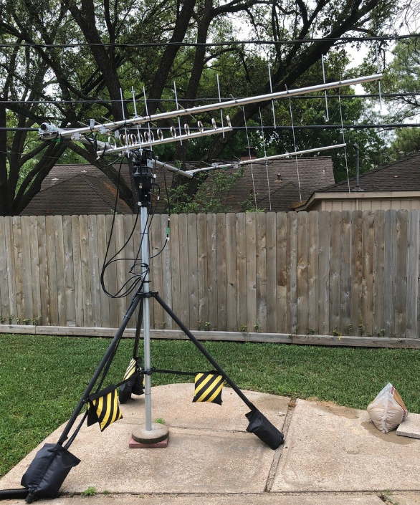
W5hrh

Slide 7
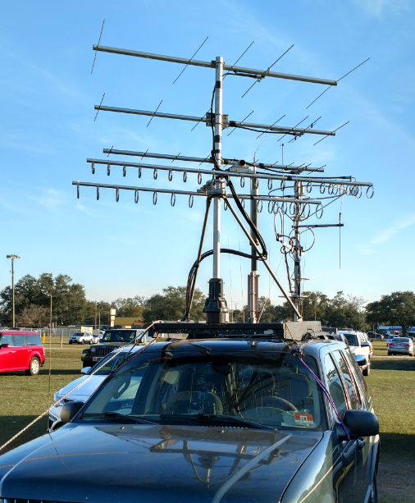
Mobile rover

Slide 8
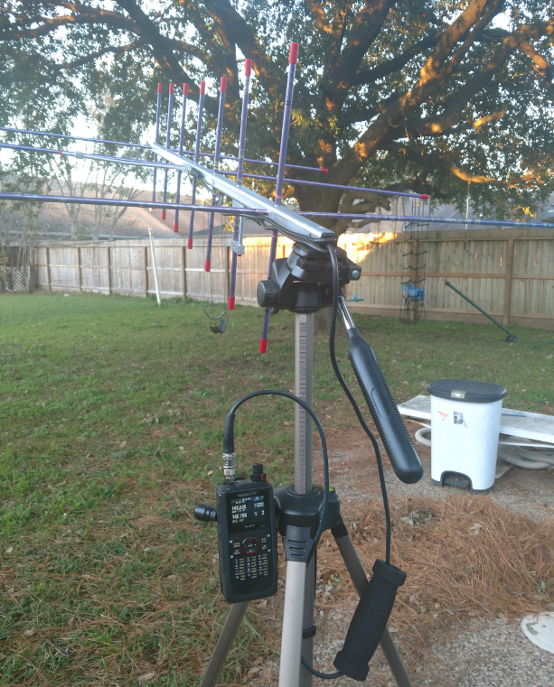
Portable

Slide 9
Most popular Radios
Satellite Radios
TS-2000, IC-9100, IC-9700, FT-847, FT-817’s, and many others
HT ‘s
TH-72 (full duplex) TH-74 (all mode receive) VX-8dr, and most any other dual-band ht

Slide 10
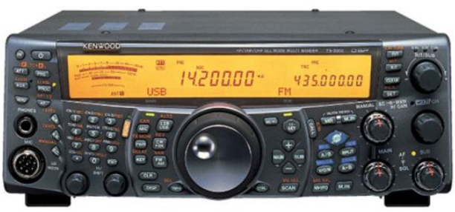
Kenwood TS-2000

Slide 11
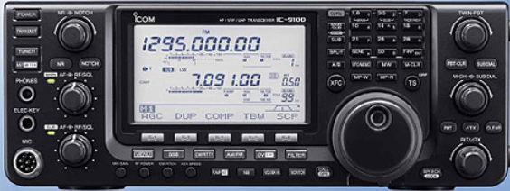
Icom ic-9100

Slide 12
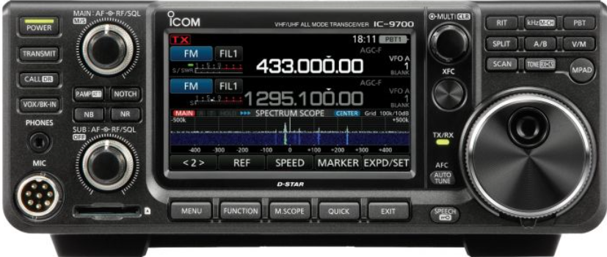
Icom ic-9700

Slide 13
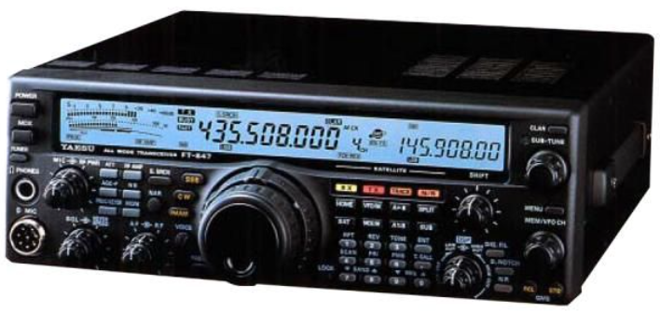
Yaesu FT-847

Slide 14
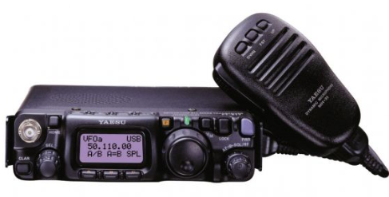
Yaesu FT-817ND

Slide 15
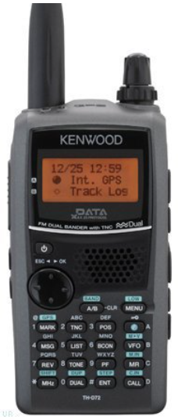
Kenwood th-d72a

Slide 16
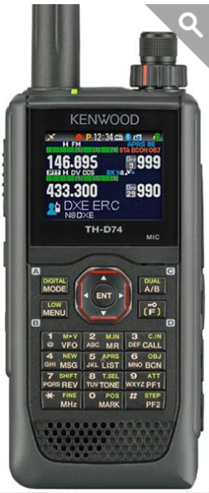
Kenwood th-d74a

Slide 17
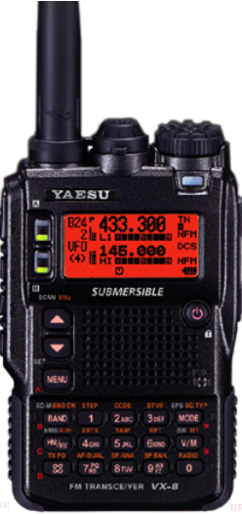
Yaesu VX-8DR

Slide 18
Most popular antennas
M2 , 2MCP8A, 436CP16, or Leo-Pack, or 2M-440xpss
Arrow (hand-held)
Elk-Arrow (longer hand-held)
Extended antenna for ht
Yaesu G-5500 az/el rotor

Slide 19
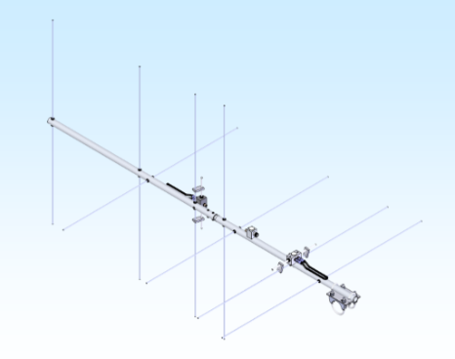
M2 2MCP8A

Slide 20
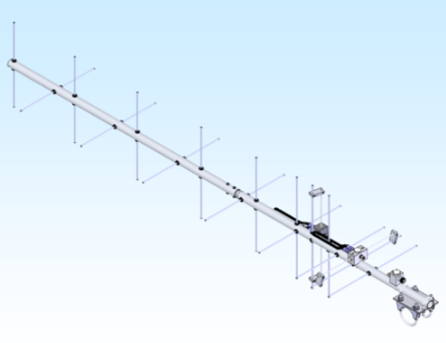
M2 436CP16

Slide 21
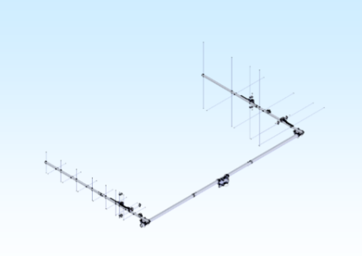
M2 LEO-pack

Slide 22
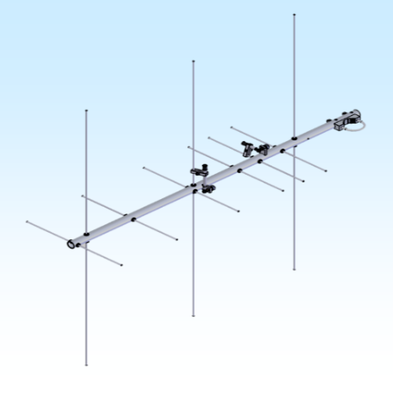
M2 2m-440xp-ss

Slide 23
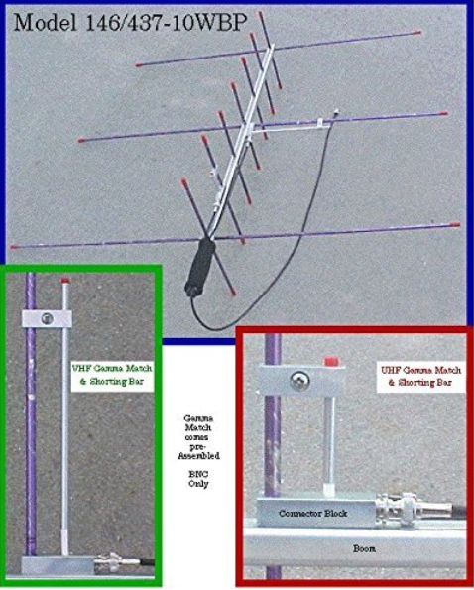
Arrow hand-held

Slide 24
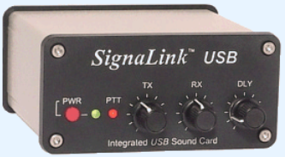
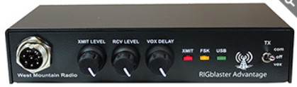

Most popular Digital Interfaces
SignaLink
Rig Blaster
MFJ-1204
Hardware or Software modem for Packet

Slide 25
Most popular software
SatPC32 (join Amsat for a free copy)
AmsatDroid (android devices)
Satellite Tracker ProSat (IOS)
Gpredict (Linux)
MacDoppler (Apple)
UISS (APRS/packet radio)
MMSSTV (slow scan tv SSTV)
Audacity (recording audio)
Robot36 (SSTV for android)
SSTV (SSTV for IOS)

Slide 26
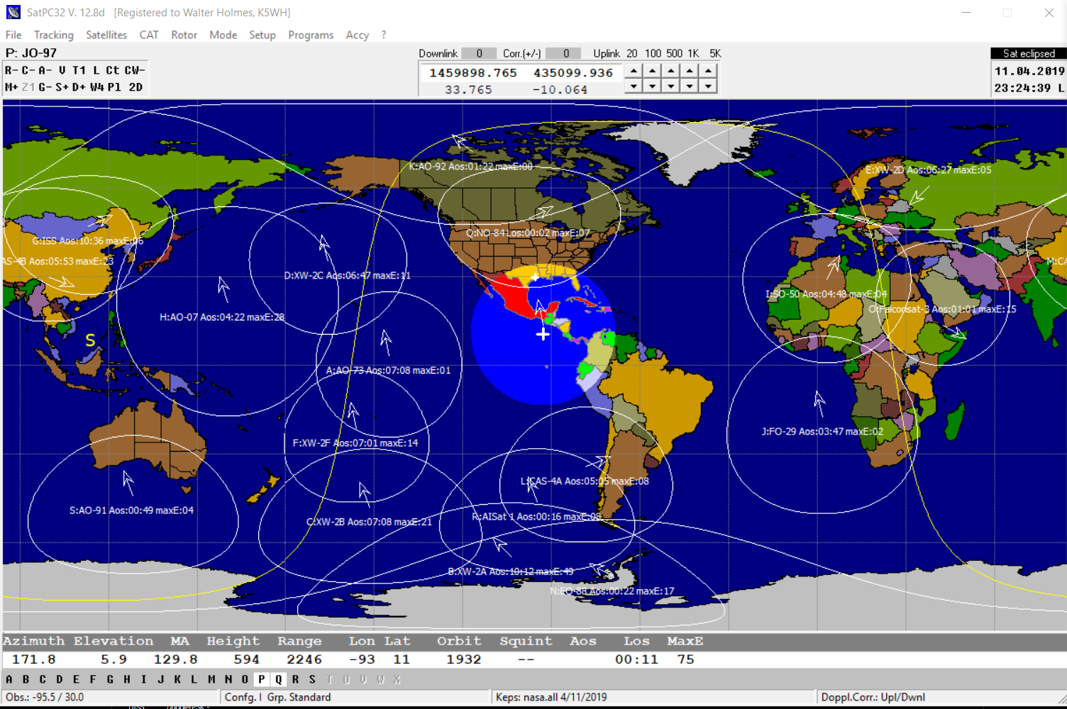
SATpc32

Slide 27

voice Satellite qso
FM sat
FM sat2
SSB sat
ISS School Contact

Slide 28
FM Repeater Satellites
SO-50 (SaudiSat-1C)
AO-85 (Fox-1A) Off until further notice due to low battery
AO-91 (RadFxSat / Fox-1B)
AO-92 (Fox-1D)
FUNcube on ESEO In commissioning
LilacSat-2 (CAS-3H) Transponder activations sporadic
IO-86 (LAPAN-A2) In equatorial orbit, activations by schedule
Diwata-2 Just activated as PO-101

Slide 29
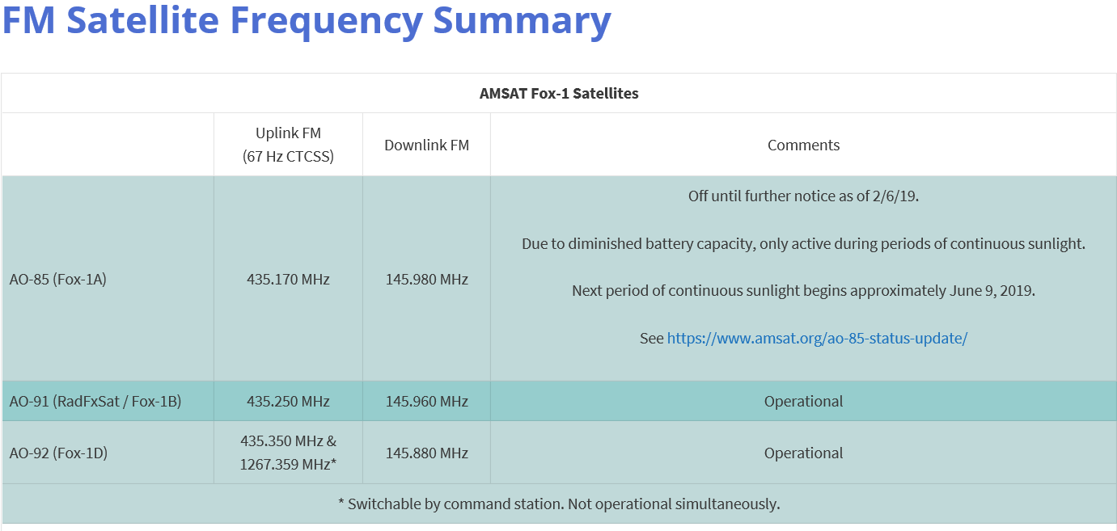
FM Repeater Satellites

Slide 30
Transponder Satellites ssb
AO-7
FO-29 (JAS-2)
AO-73 (FUNcube-1) Transponder active on weekends
XW-2A (CAS-3A)
XW-2B (CAS-3B)
XW-2C (CAS-3C)
XW-2D (CAS-3D)
XW-2F (CAS-3F)
LO-87 (LUSEX / ÑuSat-1) Transponder active sporadically over Europe and Latin America
EO-88 (Nayif-1 / FUNcube on Nayif-1) Transponder active in eclipse only
CAS-4A
CAS-4B
JO-97 (JY1Sat) In commissioning
FO-99 (NEXUS) In commissioning
QO-100 (Es’hail-2 / P4A) Geostationary at 25.9 degrees east.

Slide 31
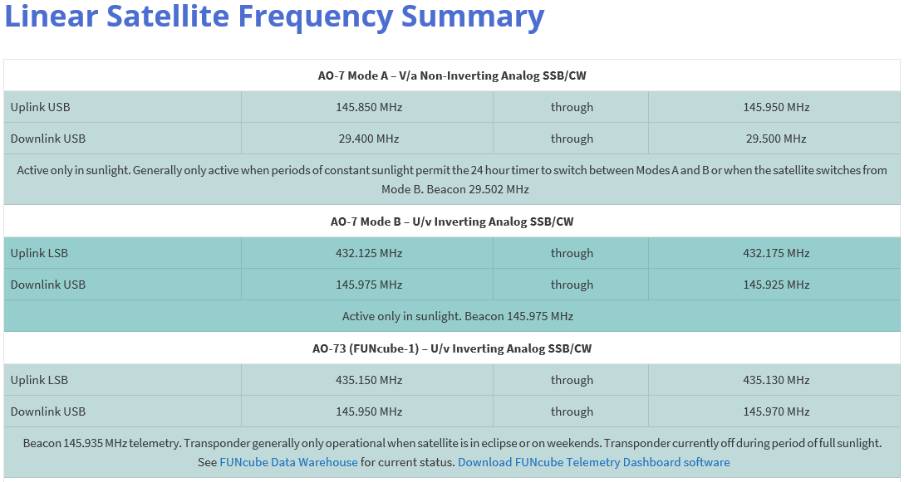
Transponder Satellites

Slide 32
Digital Satellites
FalconSAT-3 (9600 baud)
NO-44 (PCsat) Sporadically active (built using Radio Shack components)
NO-84 (PSAT) PSK31 active continuously / Digipeater when power permits
LO-90 (LilacSat-1) FM up / Codec2 digital voice down Linux Live Image for downlink Click Here (just re-entered/died)
IO-86 (LAPAN-A2) In equatorial orbit, activations by schedule
ISS Frequency Summary digipeater via ARISS
ISS Ham TV Currently inoperative
ISS using SSTV at different schedules
AISat 1 Recently activated for APRS
Diwata-2 Just activated as PO-101 APRS/FM Voice

Slide 33
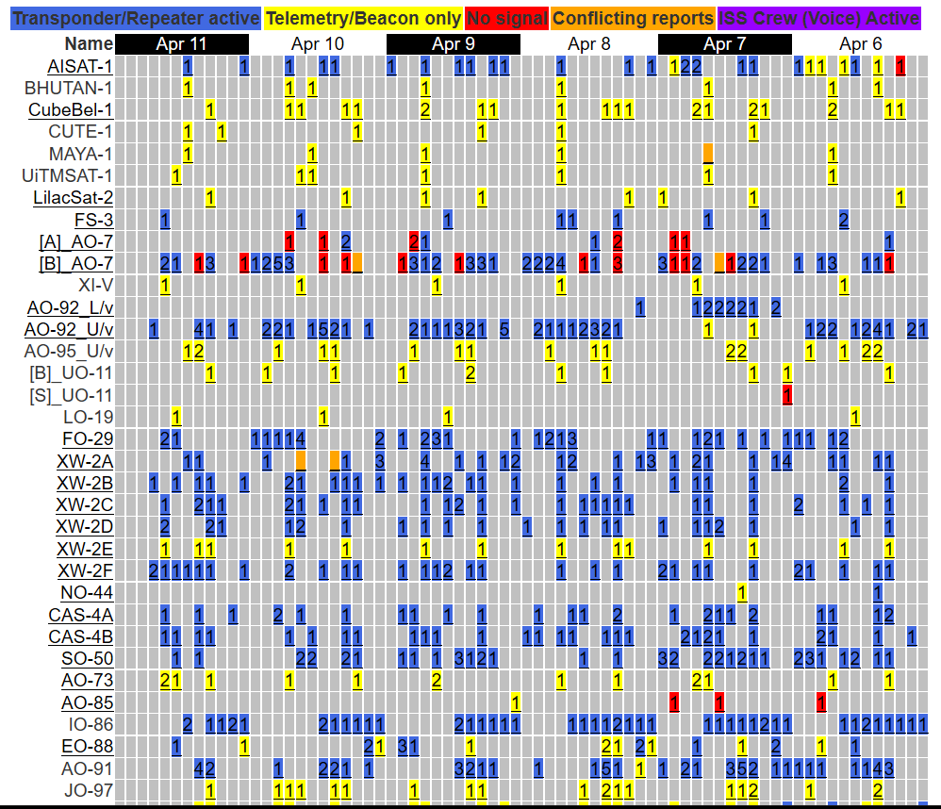
AMSAT Live OSCAR Satellite Status Page

Slide 34
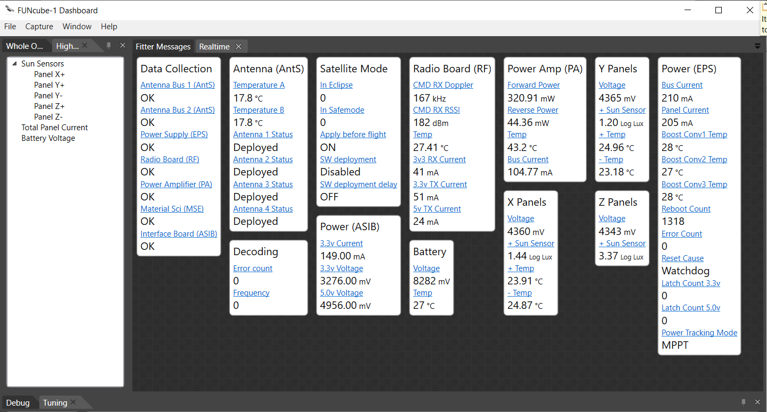
Funcube-1 (Ao-73)

Slide 35
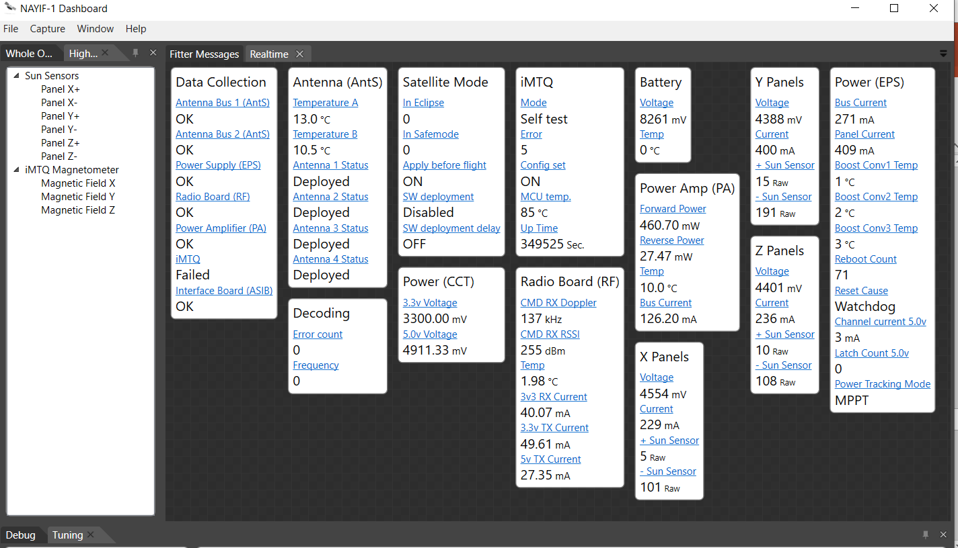
Nayif-1 Telemetry (EO-88)

Slide 36
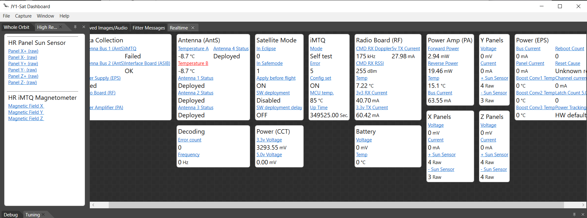
JY1sat Telemetry (JO-97)

Slide 37

JY1sat Image (JO-97)

Slide 38
What does telemetry look like
Play back a telemetry session file

Slide 39
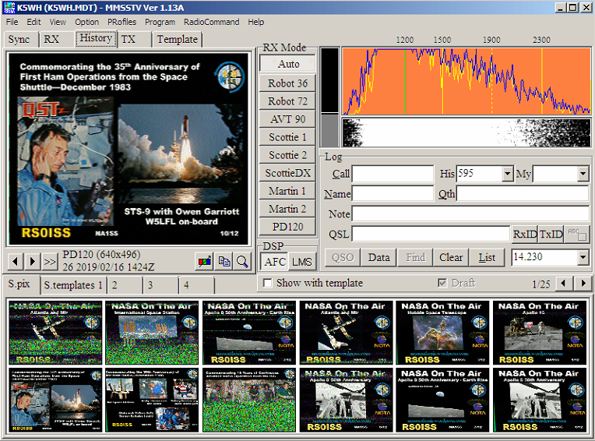
MMSSTV & sstv from iss

Slide 40

SSTV image from iss

Slide 41
What does SSTV look like
Play back an SSTV capture file

Slide 42
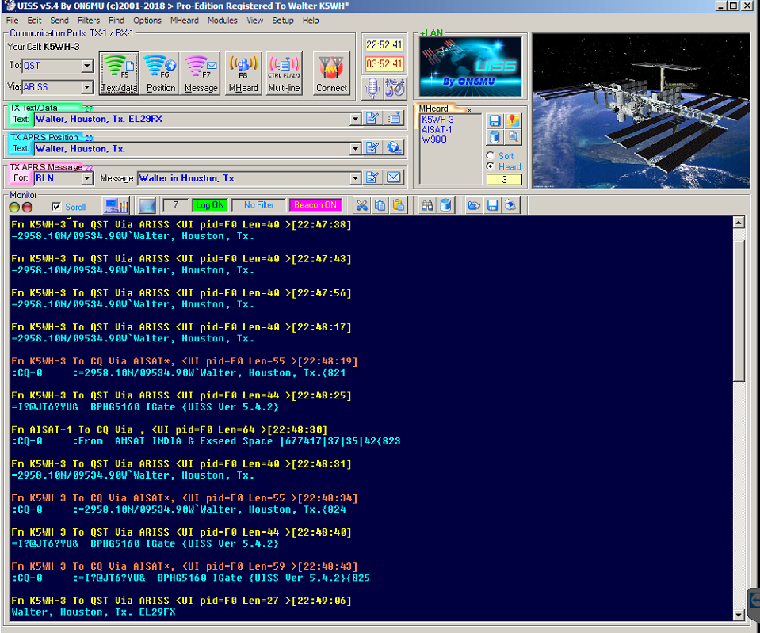
APRS via iss, NO-84, AISat-1, PO-101

Slide 43
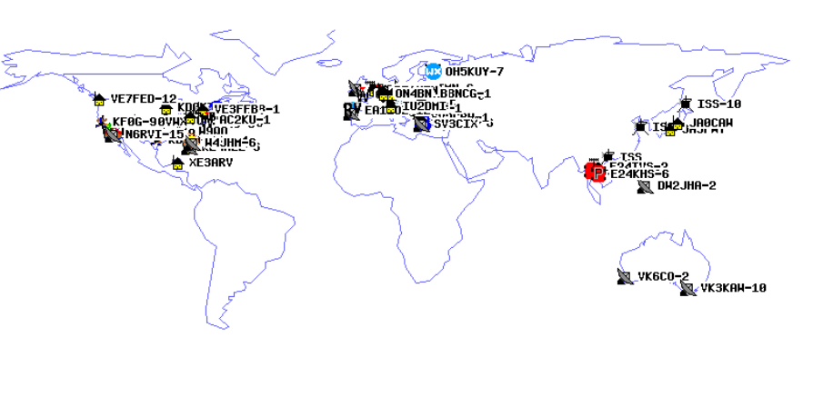
APRS via iss

Slide 44
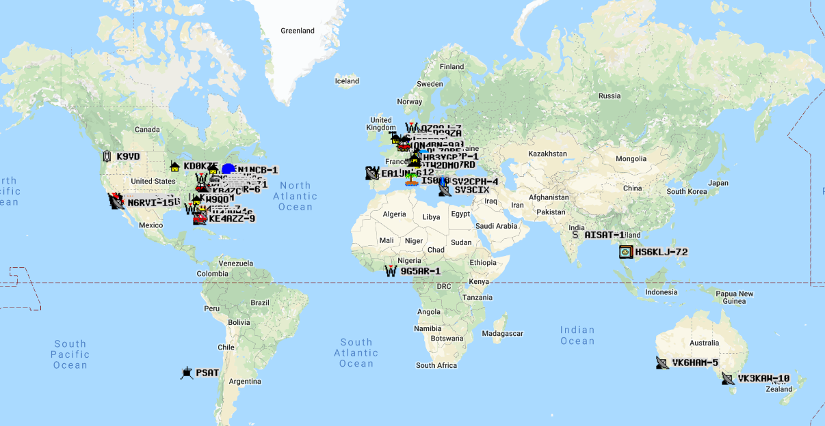
APRS via AISat-1

Slide 45
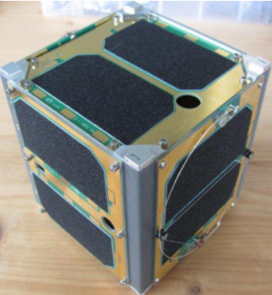


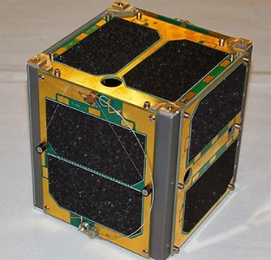
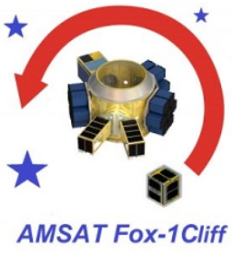
Cubesats, fox series

Slide 46
How to get involved
Houston Amsat Net Tuesday night 8pm 145.45
Or via Echolink, access AMSAT conference
HF Amsat Net Sunday 1900 UTC 14.282
Amsat.org website
DMR Talk group 98006 AMSAT
Fusion Reflector YSF 11689 US AMSAT

Slide 47
important Links https://groups.io/g/Ham-Radio-Tech-Notes/files/Technical%20Presentations
Amsat http://Amsat.org
ARISS http://ariss.net
AISat-1 http://www1.findu.com/cgi-bin/pcsat.cgi
M2 Antennas https://www.m2inc.com/
Arrow Antennas http://www.arrowantennas.com/
Signalink http://www.tigertronics.com/
Rigblaster http://www.westmountainradio.com/
MFJ-1204 https://www.mfjenterprises.com/
FUNcube Telemetry Dash Boards https://funcube.org.uk/working-documents/funcube-telemetry-dashboard/
Email: walterh@k5wh.net

